Slide 1
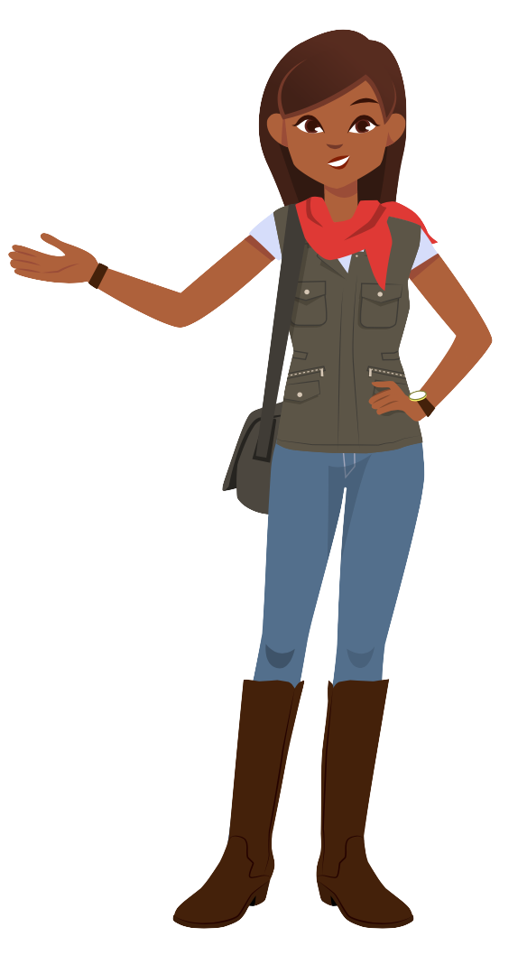
Table of Contents
Slides 2-6
Meet Amira!
Slides 7-9
Tips for Success
Slides 10-13
Logging On
Slides 14-16
Modeling Amira Lesson #1
Slides 17-19
Modeling Amira Lesson #2
Slides 20-22
Modeling Amira Lesson #3
Slides 23-33
Introducing the Benchmark Assessment

Slide 2
Meet Amira!
Student Slides
Early Reader
Skills Scaffold

Slide 3
Hi, I’m Amira!
I’m so excited to meet you!

Slide 4
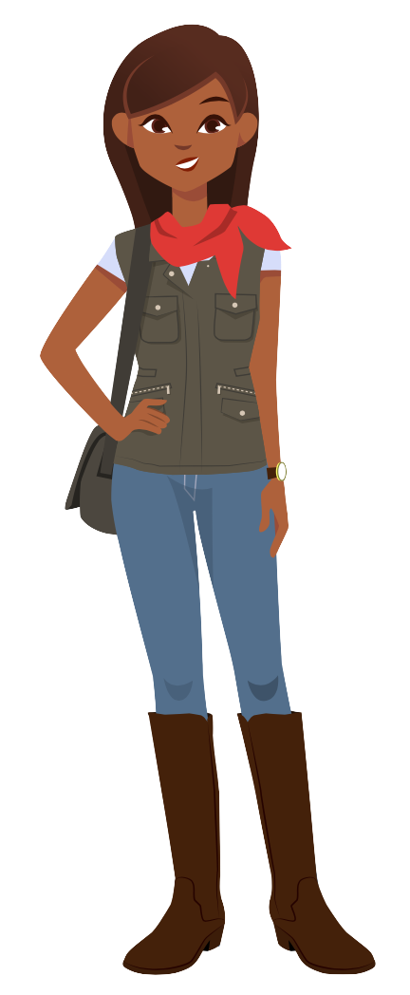
I loooove reading. I was hoping you could read with me!

Slide 5
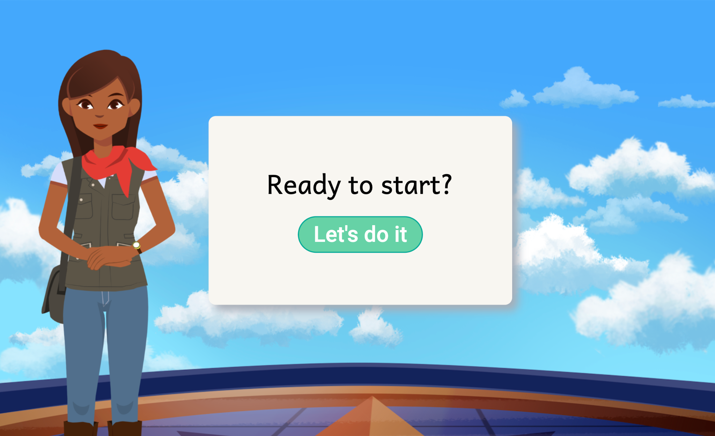
But reading with me is a little different... You can read with me on the computer!

Slide 6
Notes:
Video: https://vimeo.com/879909226

Slide 7
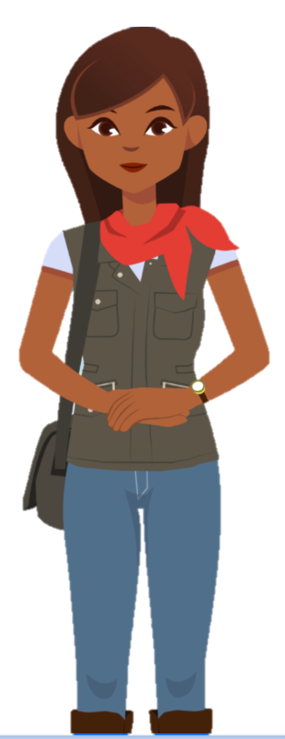
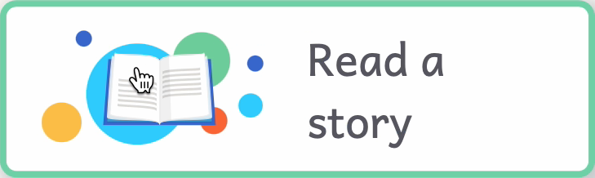
Click “Read A Story”
1
2
Read out loud
3
Try your best!

Slide 8
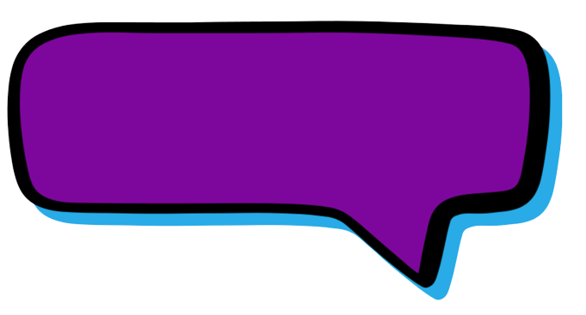
Read loud and proud so I can hear you!

Slide 9
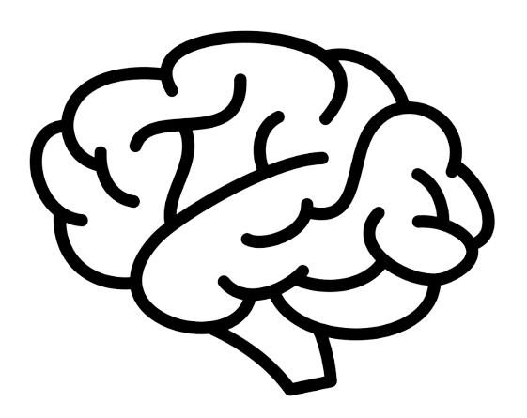
Sometimes I’ll help you with tricky parts to help you grow your brain!

Slide 10
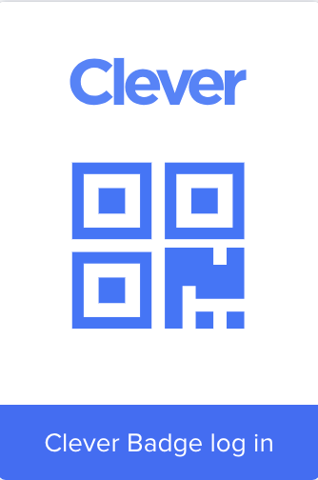
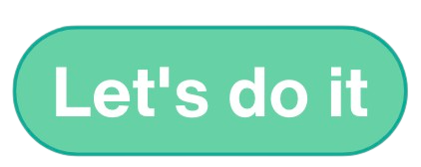
Here’s how you will log on:
1
2
3
Log into Clever
Click
Click
Notes:
Option 1: amiratutor.com

Slide 11
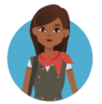
Here’s how you will log on:
1
2
3
4
Log into HMH Ed
Type your username & password
Click
Amira
Click
Notes:
Option 2: HMH Ed

Slide 12
Here’s how you will log on:
1
2
3
4
Step 1
Step 2
Step 3
Click
Notes:
Option 3: Other (add in your own login steps)

Slide 13
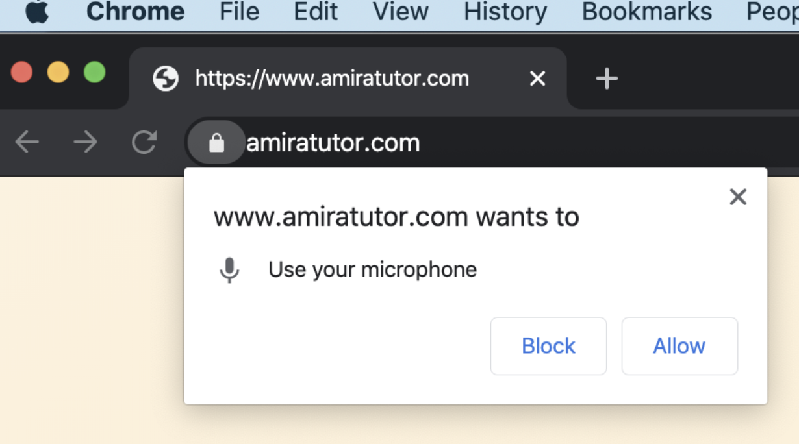
Make sure the microphone is on!

Slide 14
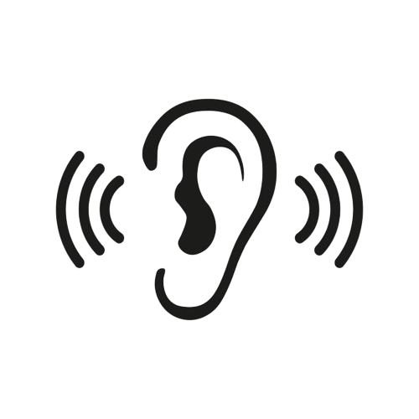
Lesson 1
Notes:
Lesson 1: https://go.amiralearning.com/hubfs/Slide%20Decks%20and%20Lesson%20Plans/ERSS_Modeling%20Amira%20Lesson%20Plan%20%231.pdf
Teacher: “I’m going to model how you will read with Amira. Today I want to teach you that we need to listen to Amira’s directions and follow her directions. She’ll tell us what to do, then show us how. Listen carefully and pay attention to her directions so that you know what to do when it’s your turn! Watch me as I read with Amira.”

Slide 15
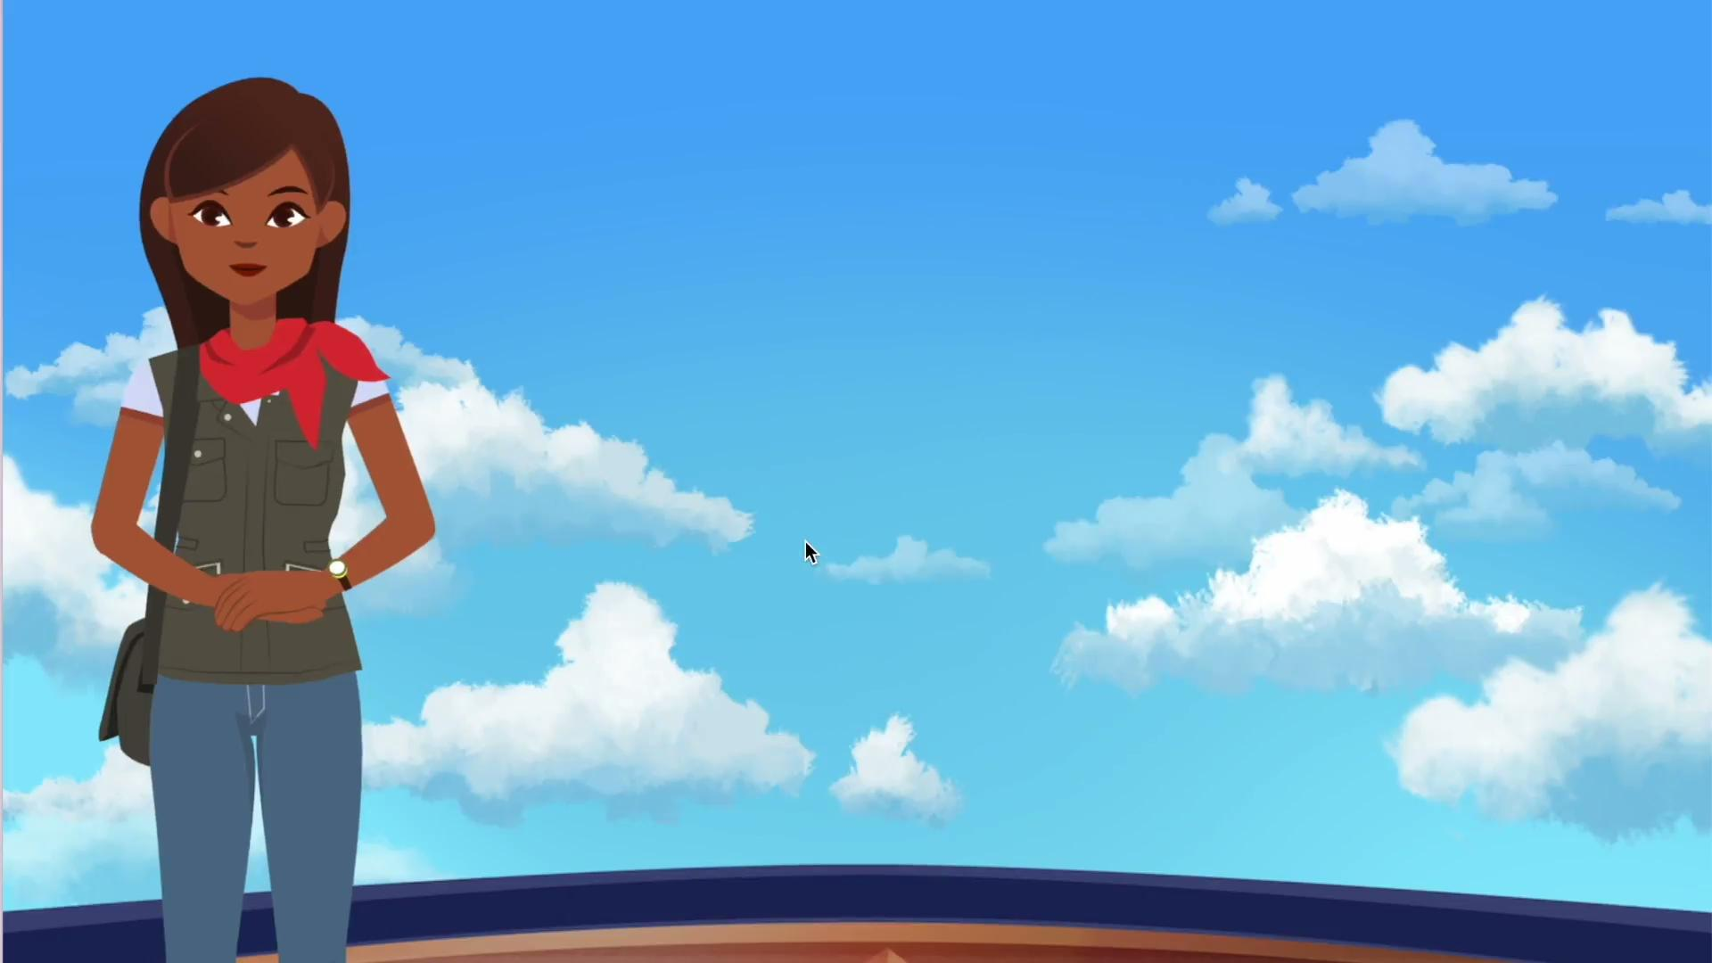
Lesson 1
Notes:
Vimeo link: https://vimeo.com/871601005

Slide 16
Reflection
Lesson 1
1. What did I do when Amira was giving directions?
2. How do I know when I’ve finished the story?
Notes:
Teacher: “Did you notice what I did at the beginning of the story? What was I doing when Amira was giving me directions?”
Students: You listened to Amira’s directions!
Teacher: “Is it time for me to read or talk when Amira is talking?”
Students: No!
Teacher: “Why?”
Students: Because then you won’t hear Amira’s directions and know what to do.
Teacher: “How do I know when I’ve finished the story?”
Students: When Amira shows you “Great work!” and tells you that you finished the story.
Students: Loud and proud voice!
Teacher: “Can I read silently to myself or do I have to read out loud?”
Students: Out loud.
Teacher: “Why?”
Students: So that Amira can hear you reading and knows when to help you.
Teacher: “How do I know when I’ve finished the story?”
Students: When Amira shows you “Great work!” and tells you that you finished the story.

Slide 17
Lesson 2
Notes:
Lesson 2: https://go.amiralearning.com/hubfs/Slide%20Decks%20and%20Lesson%20Plans/ERSS_Modeling%20Amira%20Lesson%20Plan%20%232.pdf
Teacher: “I’m going to model again how you will read with Amira. Today I want to teach you that we need to use our loud and proud voice to read with Amira! We have to read out loud, not in our heads, and we use a proud voice so that Amira can hear us.”

Slide 18
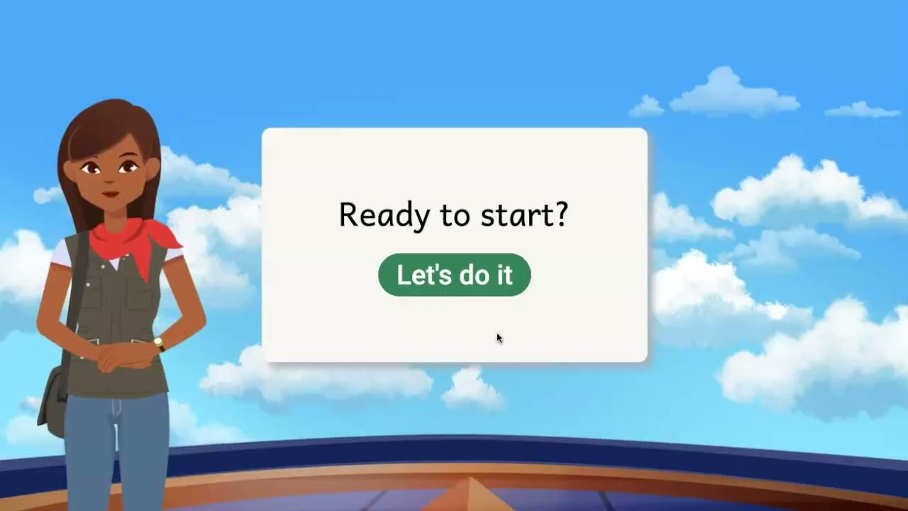
Lesson 2
Notes:
Vimeo link: https://vimeo.com/871617690

Slide 19
Reflection
Lesson 2
2. How do I know when I’ve finished the story?
1. What kind of voice did I use?
Notes:
Teacher: “Did you notice when it was my turn to read with Amira? What kind of voice did I use?”
Students: Loud and proud voice!
Teacher: “Can I read silently to myself or do I have to read out loud?”
Students: Out loud.
Teacher: “Why?”
Students: So that Amira can hear you reading and knows when to help you.
Teacher: “How do I know when I’ve finished the story?”
Students: When Amira shows you “Great work!” and tells you that you finished the story.

Slide 20
Lesson 3
Notes:
Lesson 3: https://go.amiralearning.com/hubfs/Slide%20Decks%20and%20Lesson%20Plans/ERSS_Modeling%20Amira%20Lesson%20Plan%20%233.pdf
Teacher: “I’m going to model again how you will read with Amira. Today I want to teach you that we need to use our loud and proud voice whenever there’s a green microphone. The green mic tells us Amira is ready to listen! Let me show you what I mean as I read a story with Amira today.”

Slide 21
Lesson 3
Notes:
Vimeo link: https://vimeo.com/871617864

Slide 22
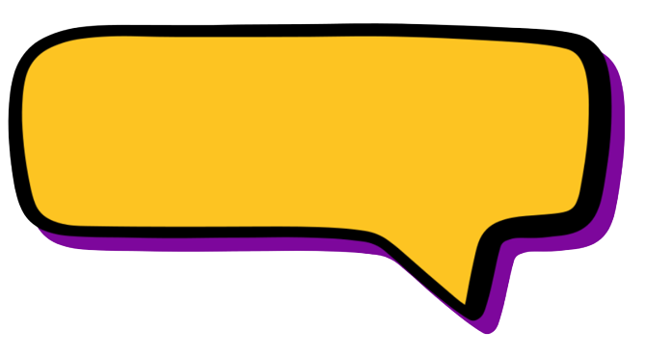
Reflection
Lesson 3
2. How do I know when I’ve finished the story?
1. What tells me it’s my turn to read out loud?
Notes:
Teacher: “Did you notice when it was my turn to read with Amira? What told me it was my turn to read out loud?”
Students: When the mic is green.
Teacher: “Can I read silently to myself or do I have to read loud and proud?”
Students: Loud and proud.
Teacher: “Why?”
Students: So that Amira can hear you reading and knows when to help you.
Teacher: “How do I know when I’ve finished the story?”
Students: When Amira shows you “Great work!” and tells you that you finished the story.

Slide 23
Intro to the
Benchmark
Assessment
Student Slides
Notes:
Lesson plan: https://go.amiralearning.com/hubfs/Slide%20Decks%20and%20Lesson%20Plans/K-2nd%20Grade_Benchmark%20Assessment%20Lesson%20Plan.pdf

Slide 24
Hi, again! Today we’re going to do something a little different!

Slide 25
When you log onto Amira, you’ll do some new tasks with me.

Slide 26
Listen to my directions.
I’ll tell you what to do
and show you how!

Slide 27
Notes:
Vimeo link: https://vimeo.com/879911034

Slide 28
Read out loud
1
2
Try your best
Say “I don’t know”
3

Slide 29
Read loud and proud so I can hear you!

Slide 30
Try your best, even when it feels tricky! Remember, you can always say “I don’t know”.

Slide 31
Watch a 1st grader take the assessment in the next video!

Slide 32
Notes:
Vimeo link: https://vimeo.com/838482157

Slide 33
Now it’s your turn! You got this!

