Slide 1
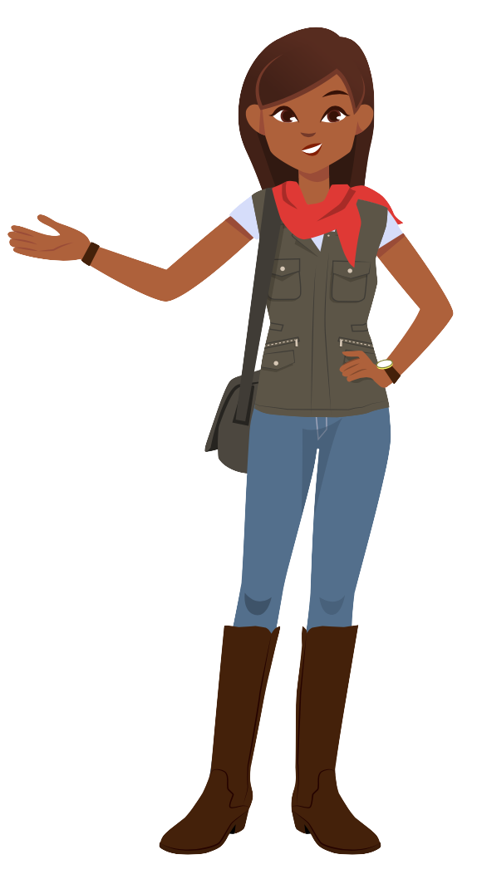
Table of Contents
Slides 2-6
Meet Amira!
Slides 7-9
Tips for Success
Slides 10-13
Logging On
Slides 14-16
Modeling Amira Lesson #1
Slides 17-19
Modeling Amira Lesson #2
Slides 20-22
Modeling Amira Lesson #3
Slides 23-33
Introducing the Benchmark Assessment

Slide 2
Meet Amira!
Student Slides
K-2nd Grade

Slide 3
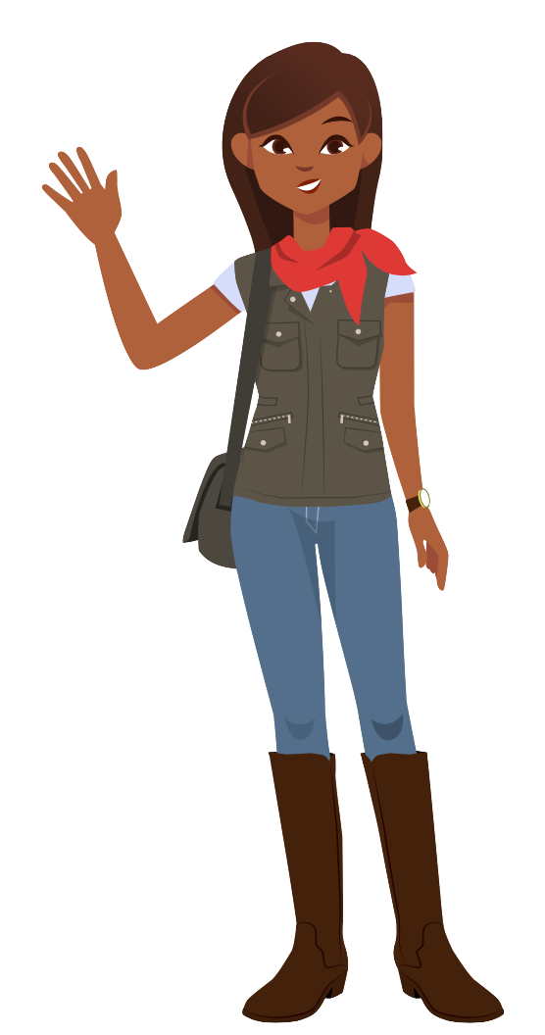
Hi, I’m Amira!
I’m so excited to meet you!

Slide 4
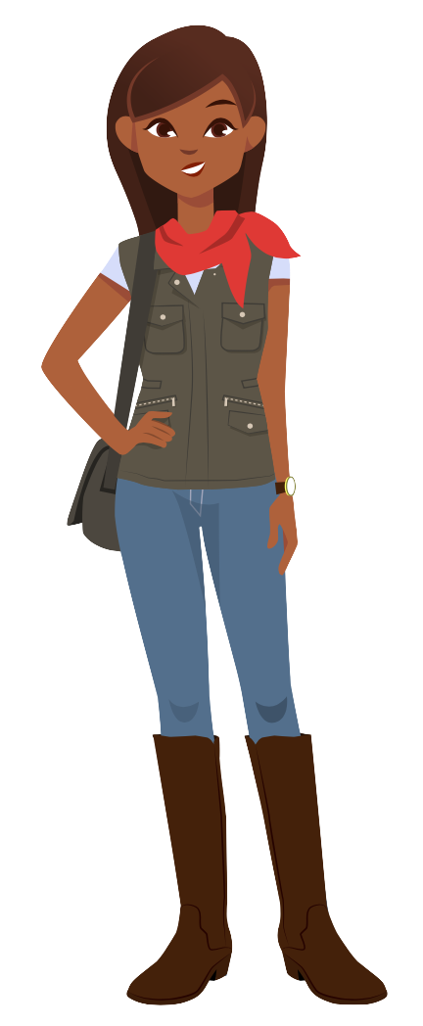
I looooooove reading.
I was hoping you could read with me!

Slide 5
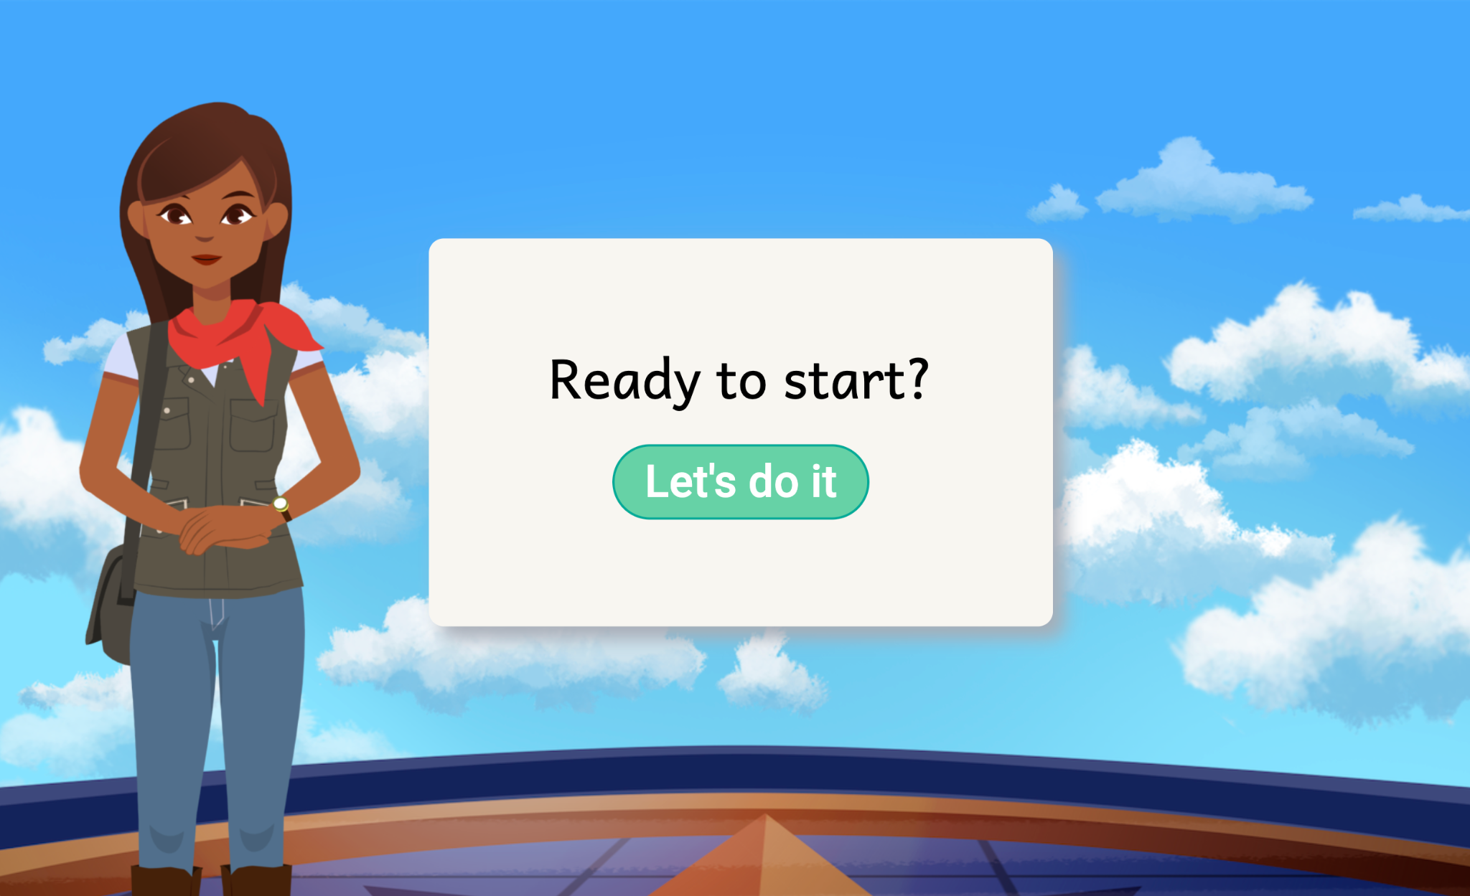
But reading with me is a little different... You can read with me on the computer!

Slide 6
Notes:
Video: https://vimeo.com/879909226

Slide 7
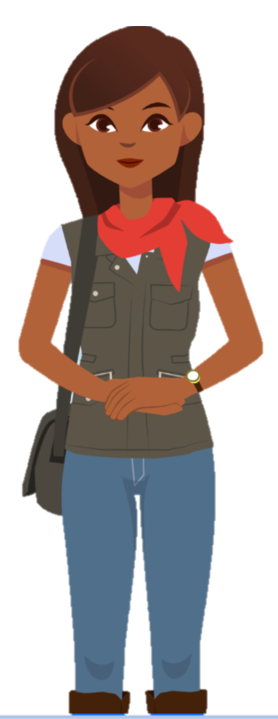
Choose a story
1
2
Read out loud
Try your best!
3

Slide 8
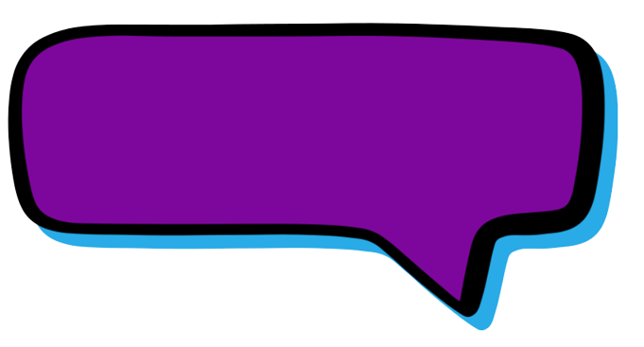
Read loud and proud so I can hear you!

Slide 9
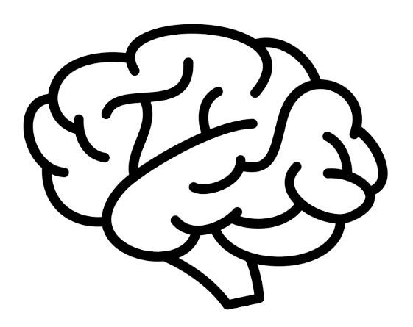
Sometimes I’ll help you with tricky words to help you grow your brain!

Slide 10
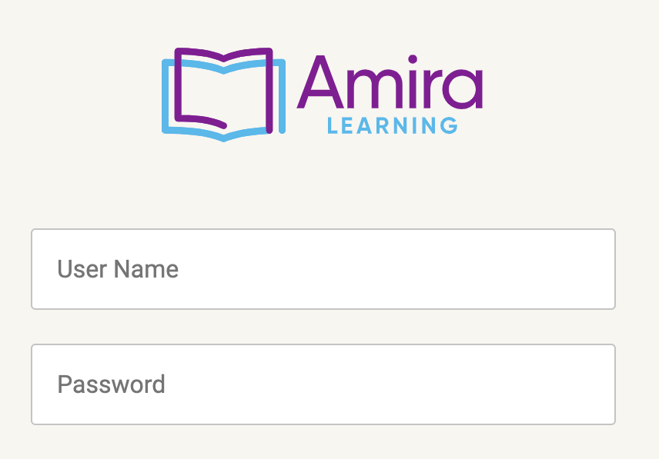
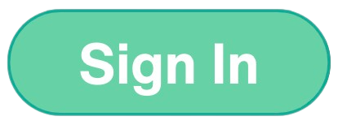
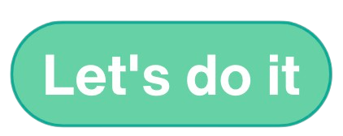
Here’s how you will log on:
1
2
3
4
Go to amiratutor.com
Type your username & password
Click
Click
Notes:
Option 1: amiratutor.com

Slide 11
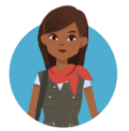
Here’s how you will log on:
1
2
3
4
Log into HMH Ed
Type your username & password
Click
Amira
Click
Notes:
Option 2: HMH Ed

Slide 12
Here’s how you will log on:
1
2
3
4
Step 1
Step 2
Step 3
Click
Notes:
Option 3: Other (add in your own login steps)

Slide 13
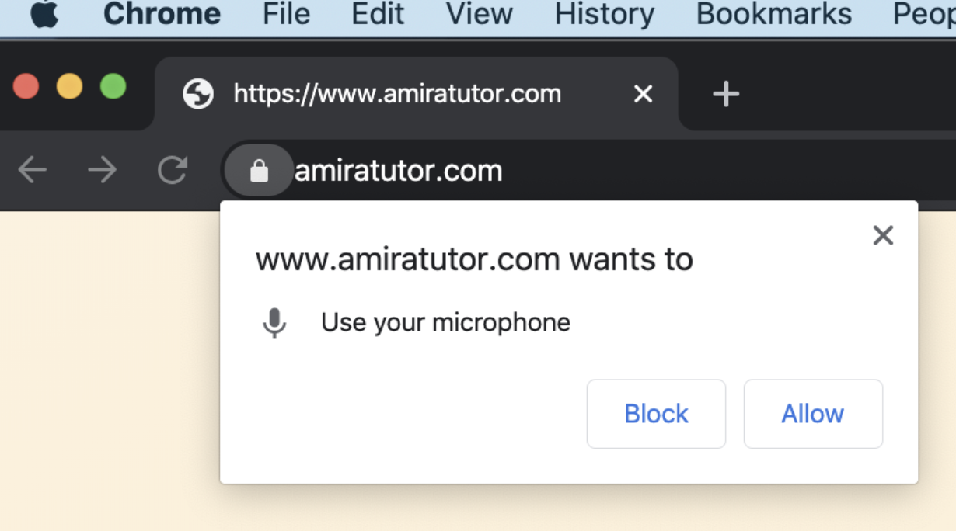
Make sure the microphone is on!

Slide 14
Now your teacher will show you how to read with me! Watch as your teacher uses a loud and proud voice!
Lesson 1
Notes:
Lesson 1: https://go.amiralearning.com/hubfs/Meet%20Amira-%20Files/K-2nd%20Grade_Modeling%20Amira%20LP%20%231.pdf

Slide 15
Lesson 1
Notes:
Vimeo link: https://vimeo.com/837714338

Slide 16
Reflection
Lesson 1
2. How do I know when I’ve finished the story?
1. What kind of voice did I use?
Notes:
Teacher: “Did you notice when it was my turn to read with Amira? What kind of voice did I use?”
Students: Loud and proud voice!
Teacher: “Can I read silently to myself or do I have to read out loud?”
Students: Out loud.
Teacher: “Why?”
Students: So that Amira can hear you reading and knows when to help you.
Teacher: “How do I know when I’ve finished the story?”
Students: When Amira shows you “Great work!” and tells you how you did.

Slide 17
Lesson 2
Notes:
Lesson 2: https://go.amiralearning.com/hubfs/Meet%20Amira-%20Files/K-2nd%20Grade_Modeling%20Amira%20LP%20%232.pdf
Teacher: “I’m going to model again how you will read with Amira. Today I want to teach you that we need to use our loud and proud voice whenever there’s a green microphone. The green mic tells us Amira is ready to listen! Let me show you what I mean as I read a story with Amira today. When I’m done, you’ll have a chance to log onto Amira and read to her today!”

Slide 18
Lesson 2
Notes:
Vimeo link: https://vimeo.com/837714467

Slide 19
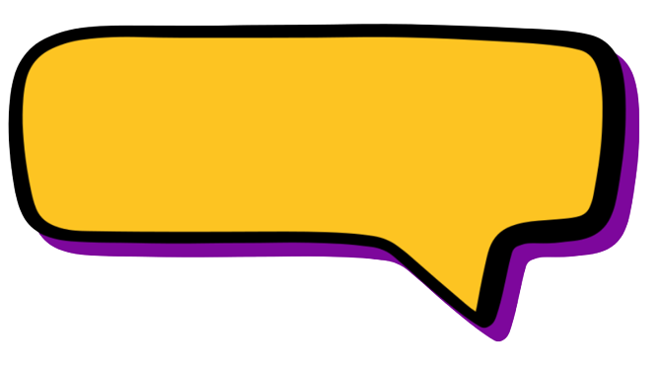
Reflection
Lesson 2
2. How do I know when I’ve finished the story?
1. What tells me it’s my turn to read out loud?
Notes:
Teacher: “Did you notice when it was my turn to read with Amira? What told me it was my turn to read out loud?”
Students: When the mic is green.
Teacher: “Can I read silently to myself or do I have to read loud and proud?”
Students: Loud and proud.
Teacher: “Why?”
Students: So that Amira can hear you reading and knows when to help you.
Teacher: “How do I know when I’ve finished the story?”
Students: When Amira shows you “Great work!” and tells you how you did.

Slide 20
Lesson 3
Notes:
Lesson 3: https://go.amiralearning.com/hubfs/Meet%20Amira-%20Files/K-2nd%20Grade_Modeling%20Amira%20LP%20%233.pdf
Teacher: “I’m going to model again how you will read with Amira. You may have noticed yesterday that as you read to Amira there is a little line under each word that moves as you read. Today I want to teach you that we should read the story smoothly and ignore that cursor. The cursor helps Amira, but you do NOT need to read the word it’s on; focus on reading the story smoothly. Let me show you what I mean as I read a story with Amira today. When I’m done, you’ll have a chance to log onto Amira and read to her!”

Slide 21
Lesson 3
Notes:
Vimeo link: https://vimeo.com/837714583

Slide 22
Reflection
Lesson 3
1. What should I remember about the cursor?
2. What should I do to make sure my story saves?
Notes:
Teacher: “Did you notice how I read to Amira with the cursor moving under the words? Did I try to stay with the cursor, or read smoothly?”
Students: Ignore it and read smoothly.
Teacher: “You got it! And what do I have to do to make sure my story saves?”
Students: Read all the way to the end, until the ‘great work!’ screen.

Slide 23
Intro to the
Benchmark
Assessment
Student Slides
Notes:
Lesson plan: https://go.amiralearning.com/hubfs/Meet%20Amira-%20Files/K-2nd%20Grade_Benchmark%20Assessment%20Lesson%20Plan.pdf

Slide 24
Hi, again! Today we’re going to do something a little different!

Slide 25
When you log onto Amira, you’ll do some new tasks with me.

Slide 26
Listen to my directions.
I’ll tell you what to do
and show you how!

Slide 27
Notes:
Vimeo: https://vimeo.com/879911034

Slide 28
Read out loud
1
2
Try your best
Say “I don’t know”
3

Slide 29
Read loud and proud so I can hear you!

Slide 30
Try your best, even when it feels tricky! Remember, you can always say “I don’t know”.

Slide 31
Watch a 1st grader take the assessment in the next video!

Slide 32
Notes:
Vimeo: https://vimeo.com/838482157

Slide 33
Now it’s your turn! You got this!

