Slide 1
Table of Contents
What’s Amira
Introducing students to Amira
Help Amira get to know your students
Getting help

Slide 2
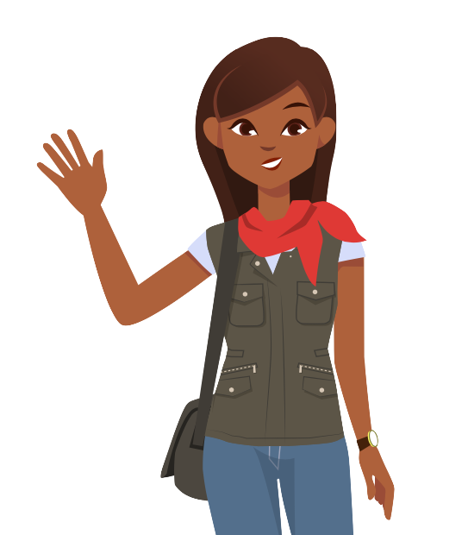
Hi! I’m Amira.
Open the hand out.
Sign in on the exit ticket.
Notes:
Welcome! While everyone’s getting settled, please open up our handout for today; I emailed it to you today with the subject line _______.
I want to set expectations up front that this session will be interactive! I’ll be introducing you to Amira and how we’re going to use it, but please ask questions as they come up and be ready to work with your team to get ready to bring Amira into your classroom.

Slide 3
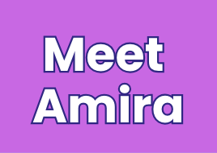
Notes:
Let’s pause for some work time. The slides and lesson plans are linked in your handout- look for the orange computer that says “Student kit”. There are two versions of everything, one for K-2nd grade, and one for 3rd-6th grade. Use this time to look through the slide deck, make a copy, and edit it to meet your needs. You can also read through the lesson plans and practice modeling reading with Amira. We’ll come back together in a few minutes. Here’s where you can access all of the resources:
The link is in your handout!
But if people are begging for the direct link: go.amiralearning.com/meet-amira-resources

Slide 4
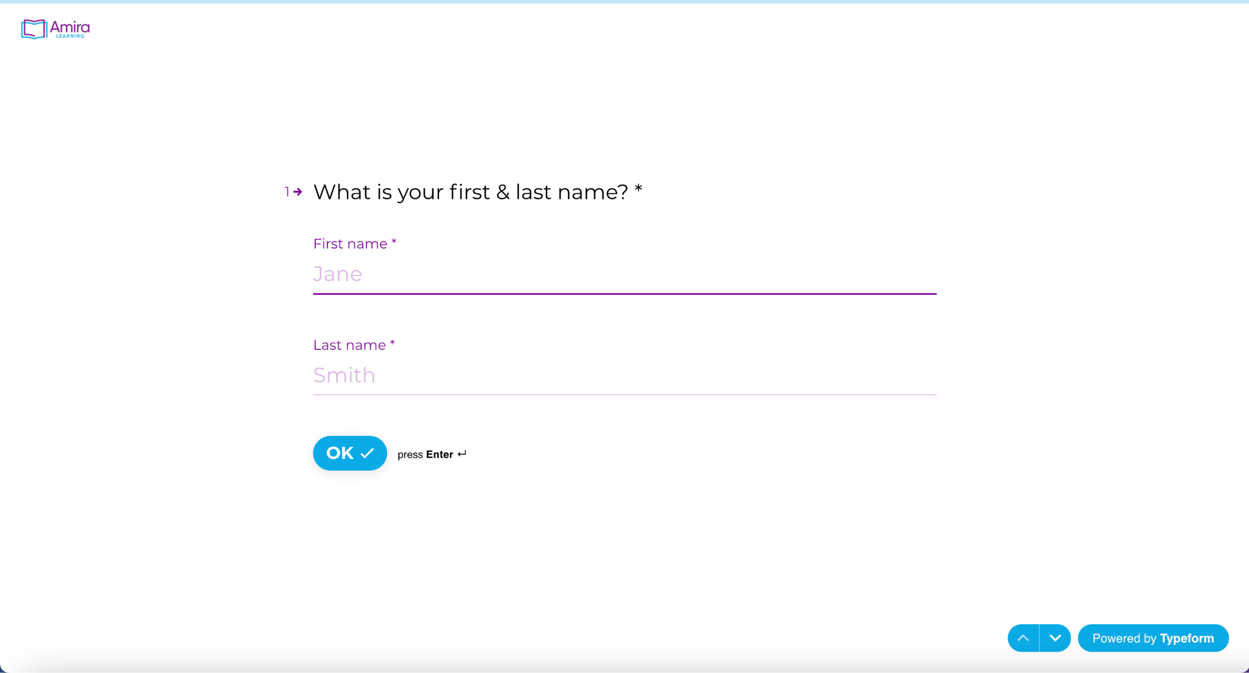
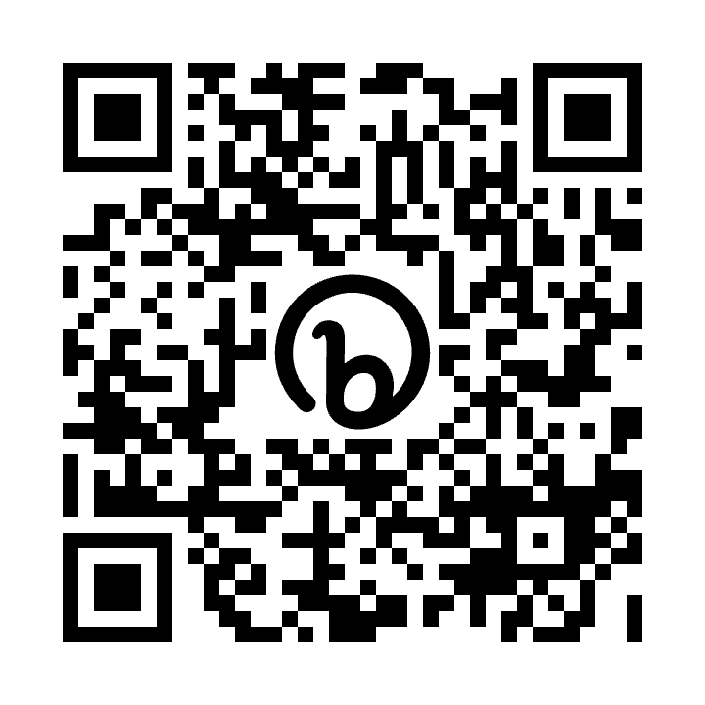
Notes:
In order to do your planning during our session, we’ll use an exit ticket that you’ll work on throughout the session during work times. Usually in a PD, you don’t get this until the end but we really trust teachers and want you have the opportunity to work on it during our time together. Once you have the handout open, at the top of the document you’ll see a blue laptop icon that says “exit ticket”; please open the exit ticket and keep it open/accessible throughout the session. I’ll give you a minute to open it now, and answer questions #1-6!
If anyone is unable to open the exit ticket and needs the direct link: https://bit.ly/meet-amira-exit-ticket . There’s also a QR code option on the slide.

Slide 5
How familiar are you with Amira?
Who’s that?
Put me in coach!
1
5
Notes:
Ok; let’s put our exit tickets to the side for now, we’ll come back to them later. Let’s start with a quick poll; show on your fingers, on a scale of 1-5, how familiar are you with Amira? Show a 1, 2, 3, 4, or 5. (Pause to check responses)
Amazing! So: (choose based on responses)
Amira is really new for most of us. I’m so excited to introduce you to her today.
Many of us are familiar with Amira. I’m so glad we have some experts here with us!

Slide 6
I’m ______!
I can help you with all things Amira!
Notes:
I’m your Amira Champion this year! You can come to me for all things Amira. If I don’t know the answer, we’ll figure it out together!
Right click and hit “replace picture” to upload your photo.

Slide 7
Every Child
Deserves the Chance to Become a Reader
Accelerating Reading Growth
AMIRA © 2022 | CONFIDENTIAL
Notes:
Let’s get started. Today will be all about accelerating your student’s reading growth with Amira.
I already know what you’re thinking: I have 1 zillion other reading programs, I can’t believe we have to do yet another thing! I get it. But, I want you to know, Amira is different.
Amira gives students the opportunity to actually practice reading aloud while getting real time feedback, and studies have proven that Amira actually accelerates reading growth.

Slide 8
As you watch, add to the chat:
How does Amira support your readers?
Notes:
Let’s start by watching Amira in action. We’re going to watch a first grader read with Amira- as he reads, think to yourself or jot down some notes: How does Amira support your readers?

Slide 9
Notes:
(Show video)
(Have 4-5 teachers share out their thoughts with the group on how Amira supports readers)
Absolutely! Students are actually reading out loud as opposed to clicking buttons or pretending to read silently in their heads. And when they struggle, Amira finds the best interventions to address the skill gap.

Slide 10
By the end of this session
You’ll have created your plan for student reading and be ready to share Amira with students.
AMIRA © 2022 | CONFIDENTIAL
Notes:
I know that you have a lot on your plate, and I want this session to be as useful as possible. We’re going to take a look at how to set up Amira so that your students can get reading. I’ll be sure to give you work time during the session so that you’re not walking away with a bunch of next steps; they’ll already be done. Our goal is that by the end of this session, you will feel confident walking into your classroom and getting your students started on Amira tomorrow.

Slide 11
Students should
read 2 stories a day
with Amira.
Notes:
Let’s jump into reading with Amira. Research shows us that students’ reading fluency DOUBLES when they read with Amira for 30 minutes per week. That’s just 10 minutes, 3 times a week. BUT, we also know that in classrooms LIFE HAPPENS; Molly’s out sick, Thursday you’re on a field trip, Friday half the kids get pulled to practice for the Peppa Pig musical. SO to get to that 30 minutes a week, students need to be reading on Amira every day. We recommend setting a goal for students to read 2 stories per day with Amira. That’s about 10 minutes every day.
Now, notice that I’m setting our goal in the number of stories, not the number of minutes. Students must complete a full story, from beginning to end, in order for their reading data to save. We’ve seen some students in the past like to go “story shopping”; they start a story, go back and choose a different one, and never actually read to the end of a story. The only way students are going to get better at reading is to practice reading with coaching and support; so they must complete the full story to the end. That will also ensure that you can hear their recording and see the data from their reading.
We’ve said two stories a day as a general goal. For students who are more advanced readers and are reading longer stories, they may only read one story in their session. As long as they’re finishing their story when they read, they should be able to reach that 30 minutes per week.

Slide 12
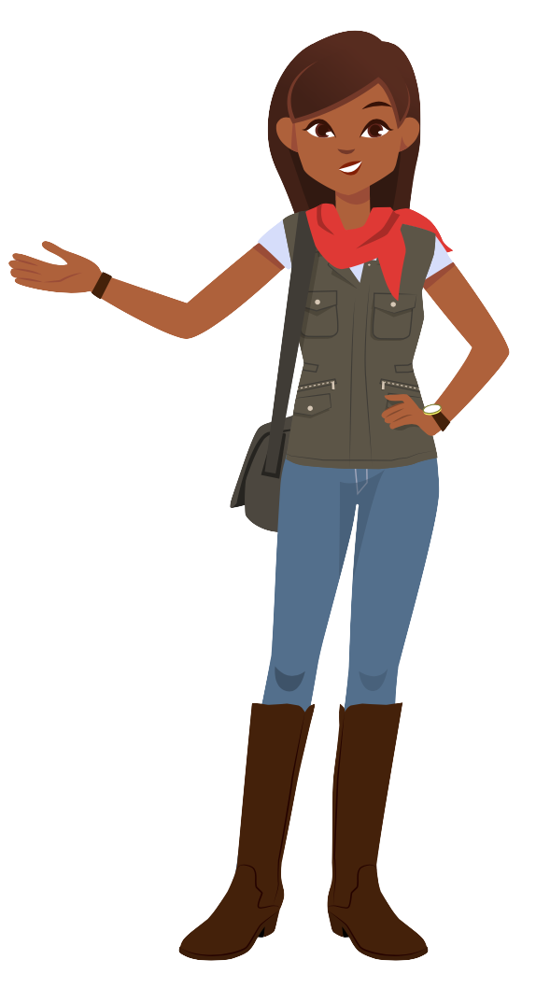
Introducing your students to Amira
There’s a learning curve to reading to an AI tutor!
model reading with Amira
set up your space
create
routines
Notes:
Now that we know why we’re here, let’s dive into how you can get your students reading with Amira. Remember your job is to get kids reading everyday. My job is to make this easy for you, so let’s get started!

Slide 13
Introducing your students to Amira
There’s a learning curve to reading to an AI tutor!
model reading with Amira
set up your space
create
routines
Notes:
First, let’s walk through exactly what your students will see when they’re reading with Amira.

Slide 14
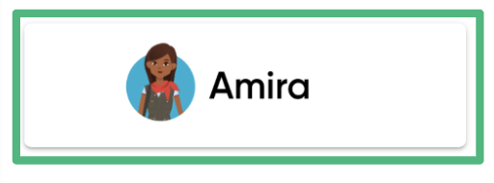
First, students launch Amira!
Notes:
Go live on your computer and the steps students will take to log in.

Slide 15
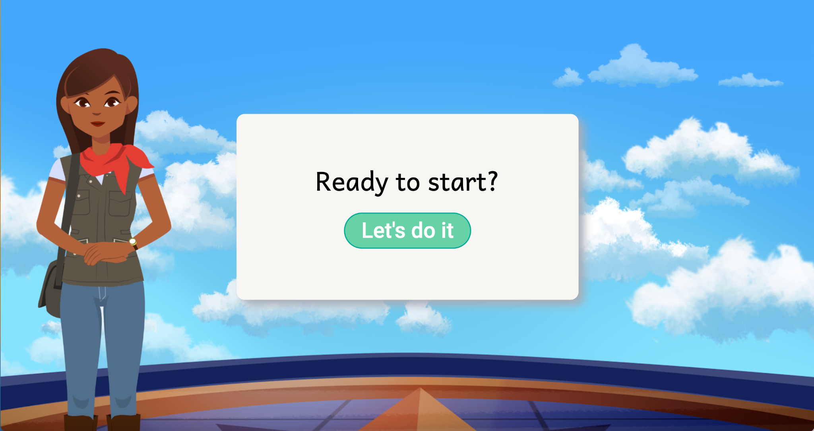
Notes:
Once students log in, they’ll press the green “Let’s do it” button.

Slide 16
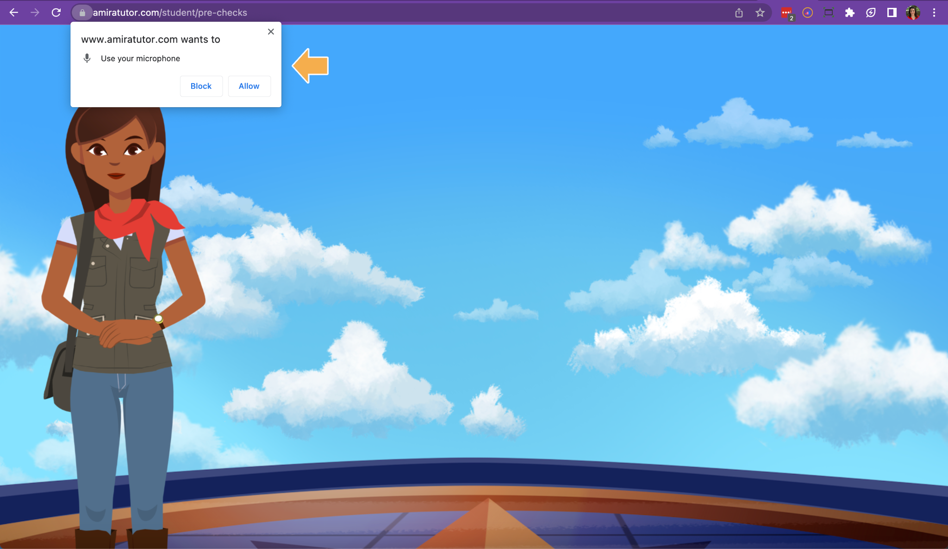
Notes:
They’ll need to hit “allow” when Amira prompts them to access the microphone.

Slide 17
Notes:
Then they’ll click “Read a story”.

Slide 18
Notes:
We know agency matters for kids and children always say they love getting to pick the story they read. All of the stories kids can choose from on Amira will be at their instructional level, so they should be able to read about 90% of the words correctly in each story. Once they choose a story, Amira will tell them “Ready, set, start!” and they can begin reading!

Slide 19
Notes:
Students should read out loud to Amira only when the microphone is green. That means Amira is ready to listen.

Slide 20
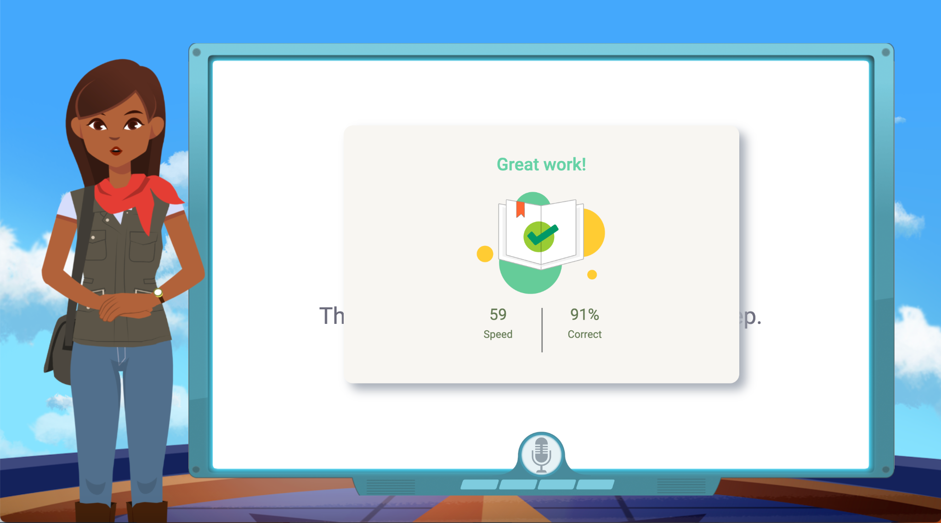
add slide that shows story compelete screen
Notes:
Students will read the story, and receive micro-interventions as needed. I’ve mentioned this already, but it’s important to know that students must completely finish a story in order for it to be saved. If students close out before finishing their story, their recording won’t be saved and you won’t be able to see their data on any of the reports. When students see this “Great work!” screen, it means they have completed the story.

Slide 21
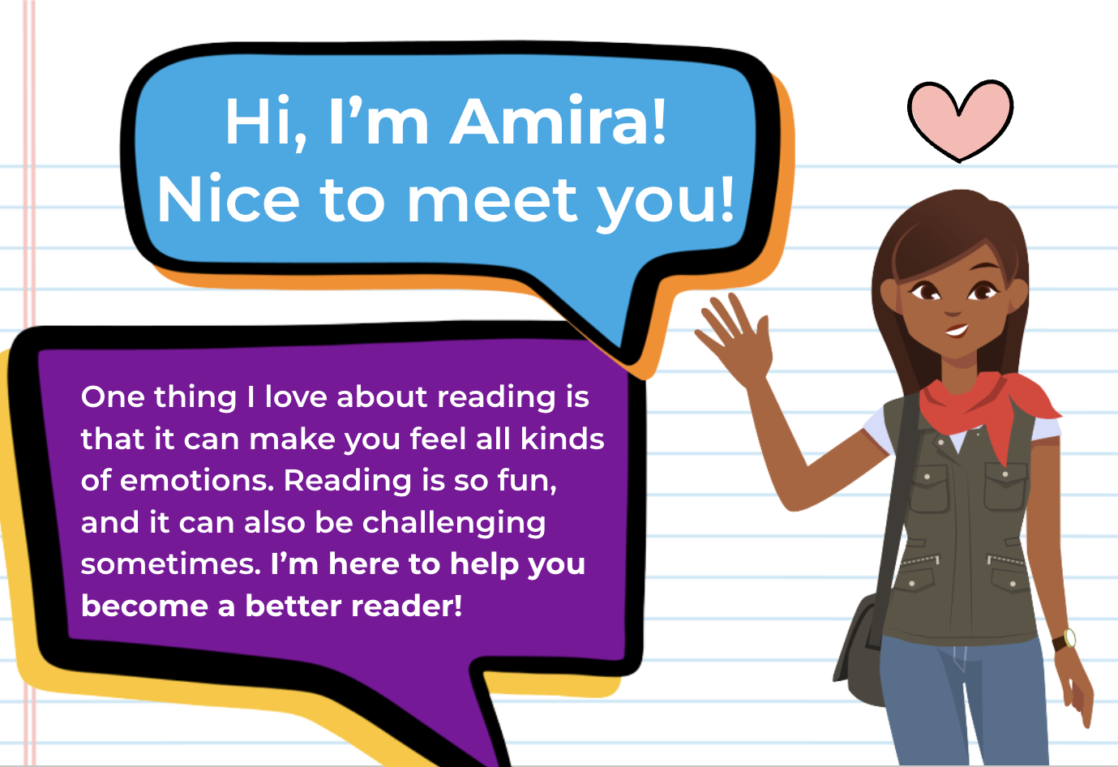
We’ve made a deck for you!
Customize to your students, or use as-is!
Notes:
Hopefully you saw that Amira supports your students similar to how you do! Now, we want to make it really easy for you to introduce Amira to them so they can get this great support! Amira has provided slides and lesson plans that you can edit to meet your needs for introducing your students to Amira.
In the lesson plans, you’ll find videos and scripts that you can use to explicitly model how to read out loud with Amira. You’ll introduce Amira with the slide deck, and then model and think aloud using the videos to emphasize some key points.

Slide 22
Teacher Work
Time
Notes:
Let’s pause for some work time. The slides and lesson plans are linked in your handout- look for the orange computer that says “Student kit”. There are two versions of everything, one for K-2nd grade, and one for 3rd-6th grade. Use this time to look through the slide deck, make a copy, and edit it to meet your needs. You can also read through the lesson plans and practice modeling reading with Amira. We’ll come back together in a few minutes. Here’s where you can access all of the resources:
The link is in your handout!
But if people are begging for the direct link: go.amiralearning.com/meet-amira-resources

Slide 23
Introducing your students to Amira
Want it to become automatic? Make it a routine!
model reading with Amira
set up your space
create
routines
Notes:
Let’s come back together!
Our next goal is to make Amira a part of your classroom routine. We’ll use this time to figure out when in your day you’ll have students read with Amira.

Slide 24
Small Group
Helps decrease the amount of noise in the room.
Provide heavy modeling and support to build independence.
Notes:
Remember, the best way to use Amira is every single day. Children only need to read with Amira for about 10 minutes to be successful and see twice the growth as they would without Amira. But every day is really, really important. You should also consider that children read out loud with Amira; this is not a silent ‘clicking buttons’ kind of program. That means you have to think about where in your day students can be a little bit noisy and actively reading.
The most common way teachers implement Amira is during reading stations. Your entire classroom is busy doing different activities, and one station is dedicated to Amira where students are logging in, putting on their headphones and reading out loud with the AI reading tutor. In order for this to work, students need to be able to use Amira independently; which means you need to put in the time up front to teach them. Use the lesson plans, slide decks, and modeling resources we just talked about to build their independence.

Slide 25
Whole Group
Ensures all students have an opportunity to read with Amira.
Consider how you will space students out so that Amira can hear them.
Notes:
Amira can work in a whole group setting. This ensures that everyone has an opportunity to read with Amira. One thing to consider is how you can set students up so that their computers (and therefore their microphones!) aren’t directly next to each other. We’ll give you some ideas for this in the next section. One thing teachers often do here is a 50/50 split with Amira and a different activity.

Slide 26
Individual
Use as bell work, in a choice menu, or homework.
Use Amira’s Tracking Report to keep tabs on who is/is not using Amira.
Notes:
Students can also use Amira during independent times like choice menus, bell work, or even at home for homework. When you use this method, make sure to use the Tracking Report to keep tabs on which students are completing their 2 stories per day. We’ll cover this a bit later in the training.
All of these are acceptable ways to implement Amira in your classroom. What you need to think about is how can I make this work every single day for every single student for about 10 minutes?

Slide 27
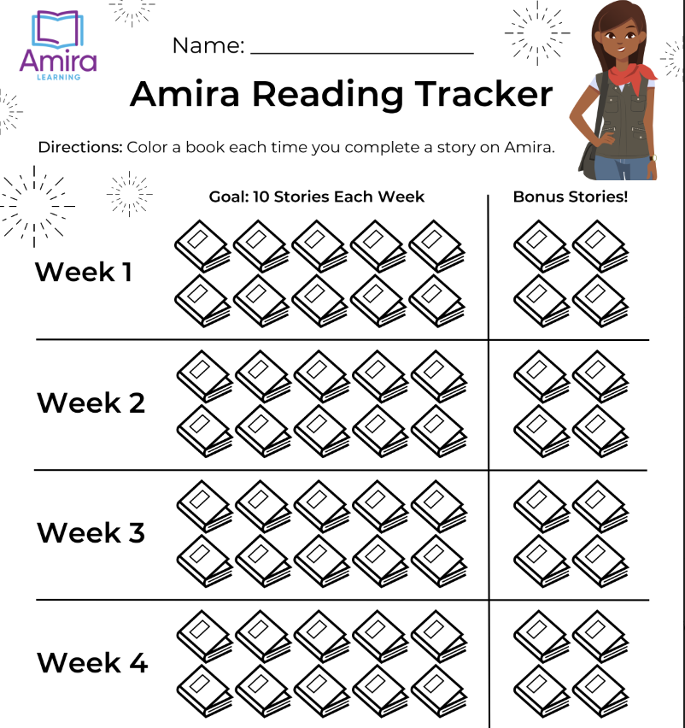
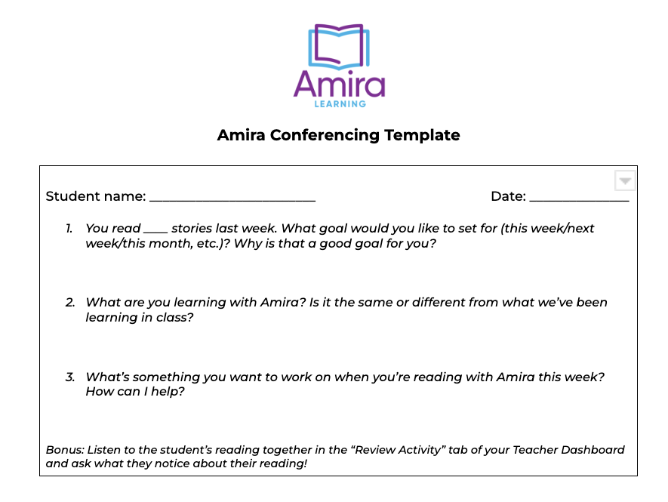
Help your students set their goals!
Notes:
One of the ways to increase student self-efficacy and independence is to help them to set goals. We’ve created a template for you to help students track the number of stories they read on Amira as well as a way to conference with your readers about what they’re learning when they’re reading with Amira.
Again, you can find these linked in your handout on the orange laptop “student kit”.
But if people are begging for the direct link: go.amiralearning.com/meet-amira-resources

Slide 28
Introducing your students to Amira
Let’s remove any barriers to success!
model reading with Amira
set up your space
create
routines
Notes:
Finally, the last consideration is setting up your space.

Slide 29
Help Amira Hear
Headphones
help
Face devices in different directions
Wait for the green mic
Notes:
Here are a few tips to make reading with Amira go smoothly!
Headphones help. Amira can hear without headphones so if you don’t have them, don’t worry. But if you do, it can help Amira hear and can reduce distractions for students.
Amira is designed to key in on the voice directly in front of her. She’s designed to work in a busy classroom. That said, you can help her out by making sure that students are not directly next to each other to make it easier for her to tell which voice to focus on. It often works well if students’ computers are facing each other, like sitting at the four ends of a compass.
Amira lets students know when she’s ready to read by turning the mic green. Sometimes students don’t look for that and then think Amira can’t hear them! Coach them to look for the green mic before they read to Amira.

Slide 30
Don’t forget a device routine
Set up a routine to restart your devices.
Notes:
One other pro tip is to have a device maintenance routine. Restarting devices will make all your programs run faster. As with any other technology, Amira is only as smart as the computer she’s running on. Set a cadence for restarting devices - we recommend once a week. As a teacher, this was something it was easy to teach students to get in the habit of doing at the beginning of the year. There’s a resource in your handout for how to do this, if you click on the teal “How To’s” laptop!

Slide 31
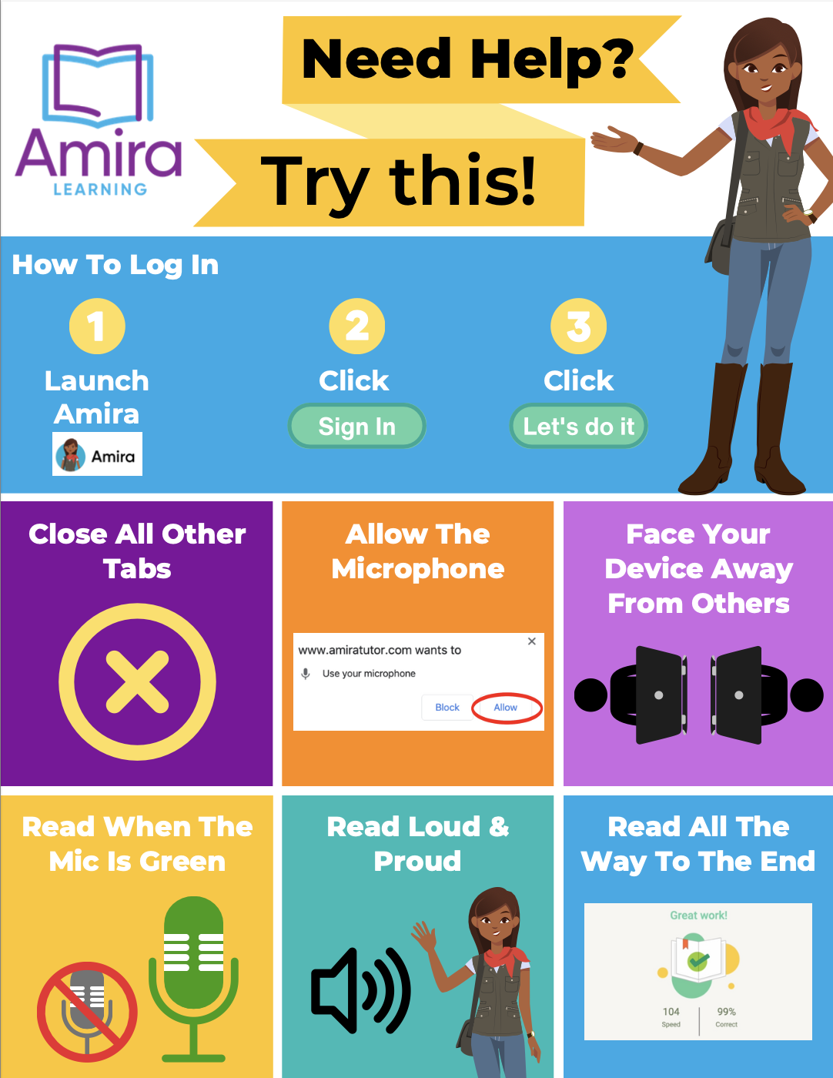
Download our student routine poster!
Notes:
We also know that students often need visual cues when you’re starting a new routine. Amira has a printable poster that you can hang in your classroom to help students help themselves when reading with Amira. This linked in the Student Kit on your handout!
But if people are begging for the direct link: go.amiralearning.com/meet-amira-resources

Slide 32
Tips from teachers
“I tell all my students that Amira is my friend and she’s going to help them read. Then, I model what it looks like in the program.”
“I modeled using Amira every day for the first few weeks so my students knew exactly what to expect. It was worth it!”
“Every student knows to make Amira their first or second station because I will be checking their recordings.”
Kindergarten teacher,
Kentucky
3rd grade teacher,
Utah
5th grade teacher,
Michigan
Notes:
We’re about to head into some work time. Before we do, I want to share a few tips from teachers!
Reading to an AI robot is weird! Introduce Amira as your friend. Students tell us they love that Amira listens to them and helps them, but they need to know that from the person they really trust - YOU!
Again, your students have probably never read out loud to a computer before. One of the best ways you can help students be successful with Amira is modeling. I’ve already shared our lesson plans and videos to help you show them what to do. Show them examples and non examples! ex. reading loud vs soft, reading right next to someone else vs. giving a little space, etc. Think aloud to emphasize important key points.
This is not like other programs where students can passively sit and click; Amira holds students accountable to ACTUALLY reading. The best way to do this is to check student recordings and hear them reading! This can help you get a better idea of their skills as a reader and allow you to make sure that the learning magic is happening! It can also be extremely motivating to let students hear their own recordings, so they know how their reading sounds and how they’re improving. I’ll show you how to check this in the next section.

Slide 33
Teacher Work
Time
9/1
Notes:
Let’s pause for some work time again. On your handout, you can type in the date you’ll introduce Amira to your students and determine whether you will have students read with Amira in small groups, whole group, or individually. Get with your team, talk it out and make decisions, and then record your thoughts on questions #7-9 on your exit ticket. We’ll come back together in a few minutes!
go.amiralearning.com/meet-amira-resources

Slide 34
Help Amira get to know your students
Getting to know your students helps me support them!
Tracking Report
Setting up assessment
Log in
Notes:
Okay we’ve talked a lot about kids, now let’s talk about your set up! We’re going to spend the rest of the time together making sure you have time to get your students set up! In order to do this, you’ll first need to get logged in. Let me show you how!

Slide 35
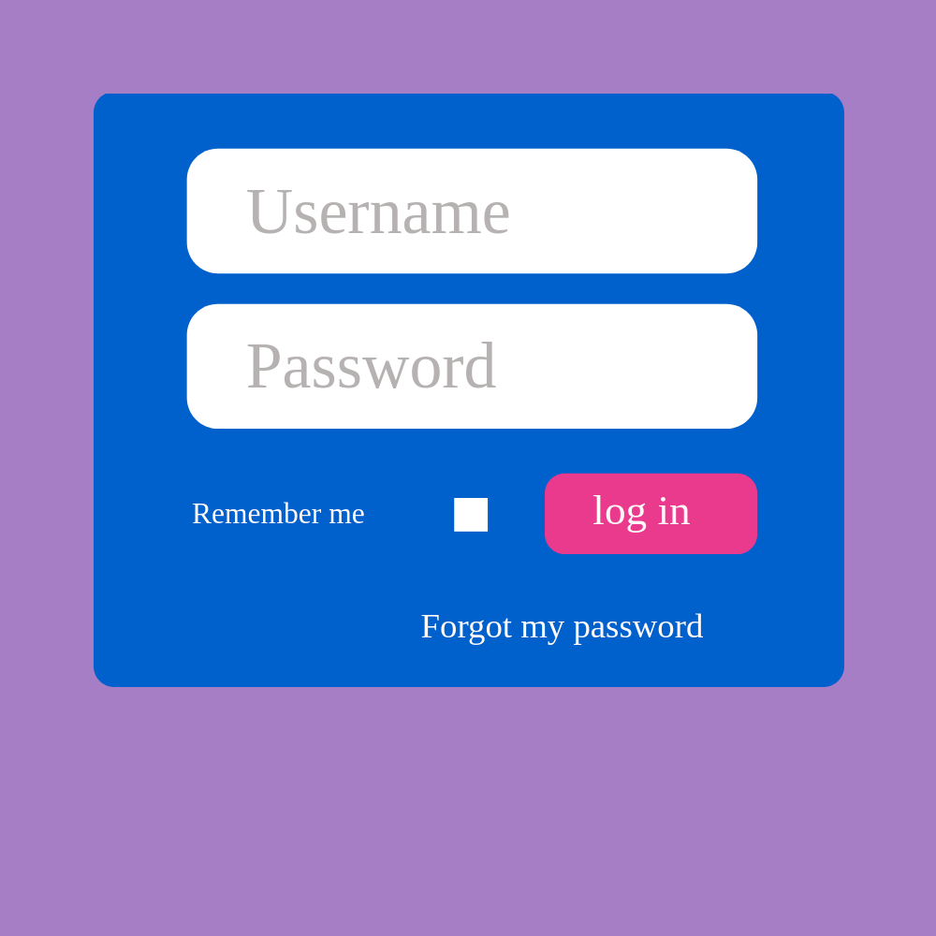
First, let’s log in!
Notes:
Go live on your computer and show your teachers the steps they need to take to log in.

Slide 36
Help Amira get to know your students
Getting to know your students helps me support them!
Tracking Report
Setting up assessment
Log in
Notes:
Now that we’re logged into Amira, let’s look at how to use Amira from the teacher end.

Slide 37
Help Amira get to know your students
The Tracking Report is going to be your new best friend!
Tracking Report
Setting up assessment
Log in
Notes:
Amira has a ton of amazing reports, but those are only going to be interesting to you once your students start reading on Amira. Today we’re only going to look at one single report. If you remember nothing else: 1) students should read with Amira every day, and 2) use the Tracking Report!

Slide 38
Notes:
Select the Tracking Report. This is your go-to place for seeing what your students are doing on Amira and making any adjustments to their Amira experience.

Slide 39
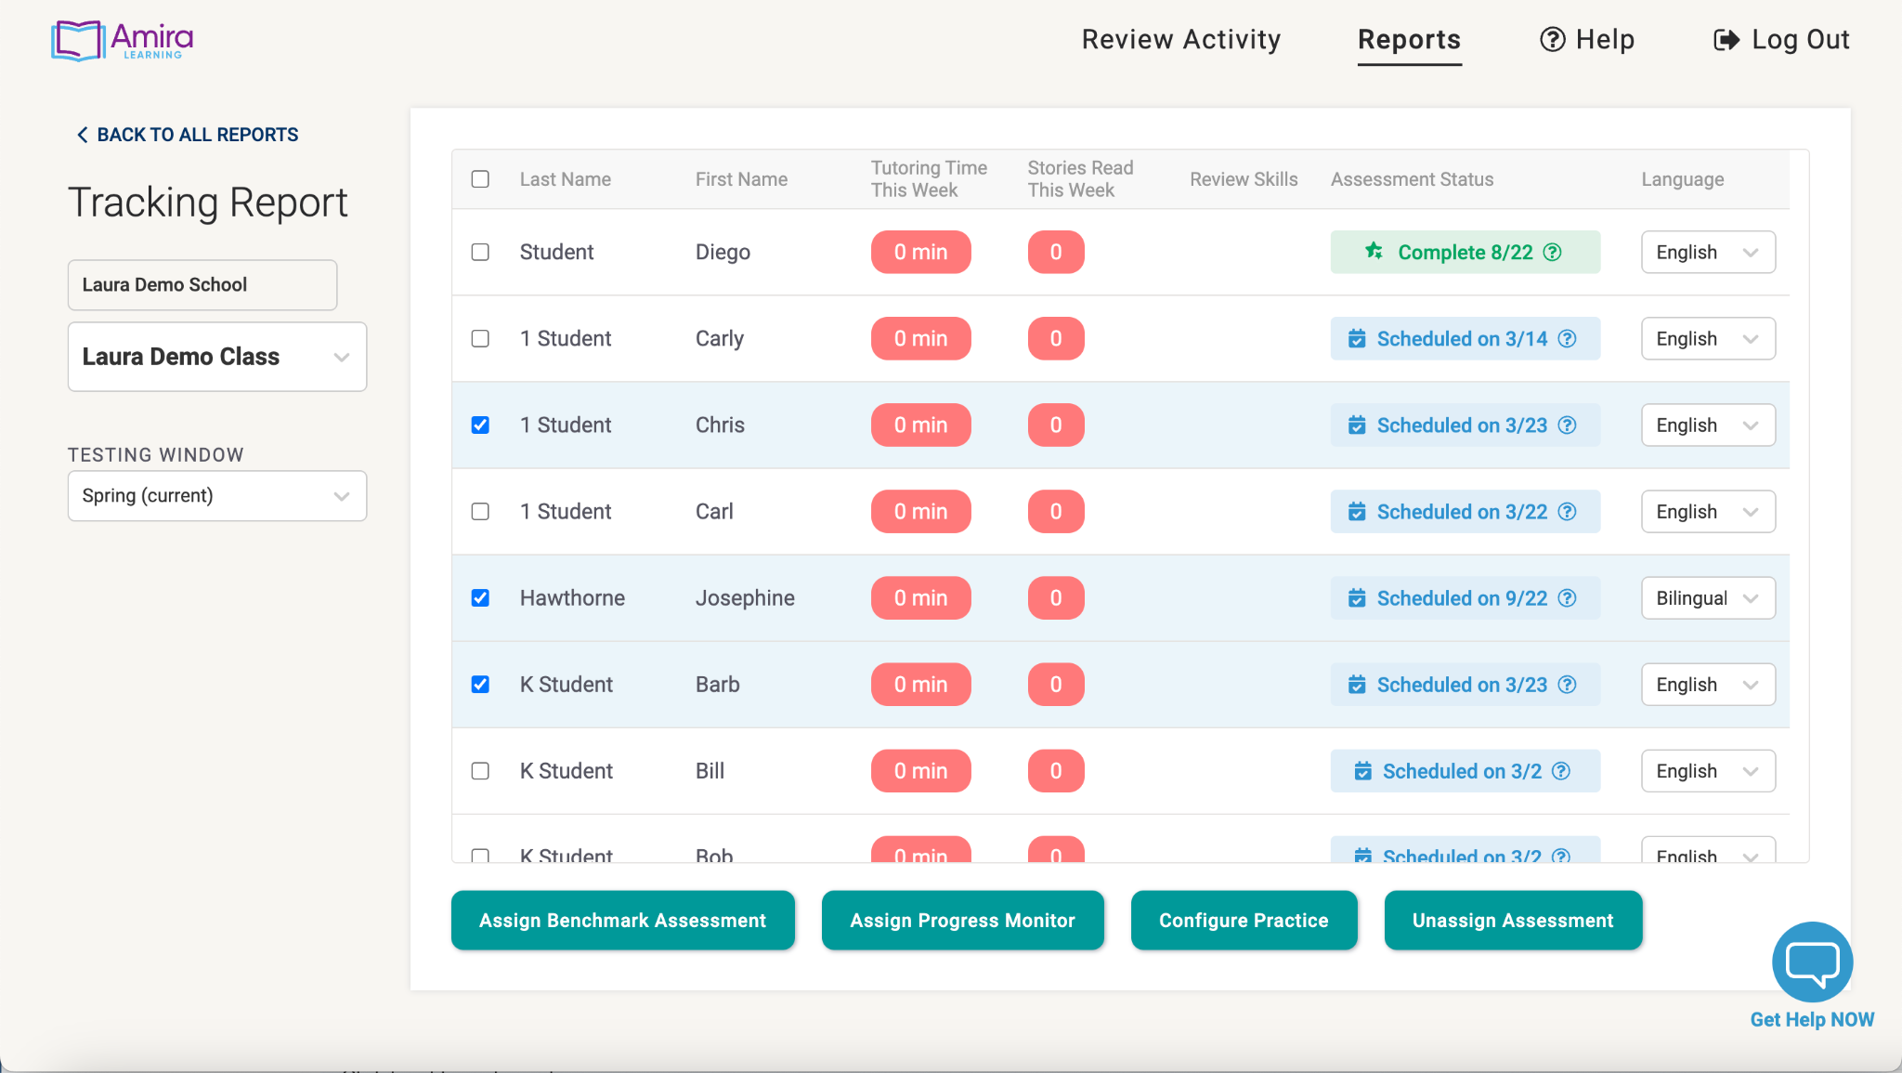
Notes:
We talked about students reading 2 stories per day. The Tracking Report is where you are able to check this! You will likely scan the Tracking Report daily to monitor which of your students are reading 2 stories per day, and which students may need some support.
Take a minute to navigate to the Tracking Report now. I’m going to show you how to get there one more time because it’s that important!

Slide 40
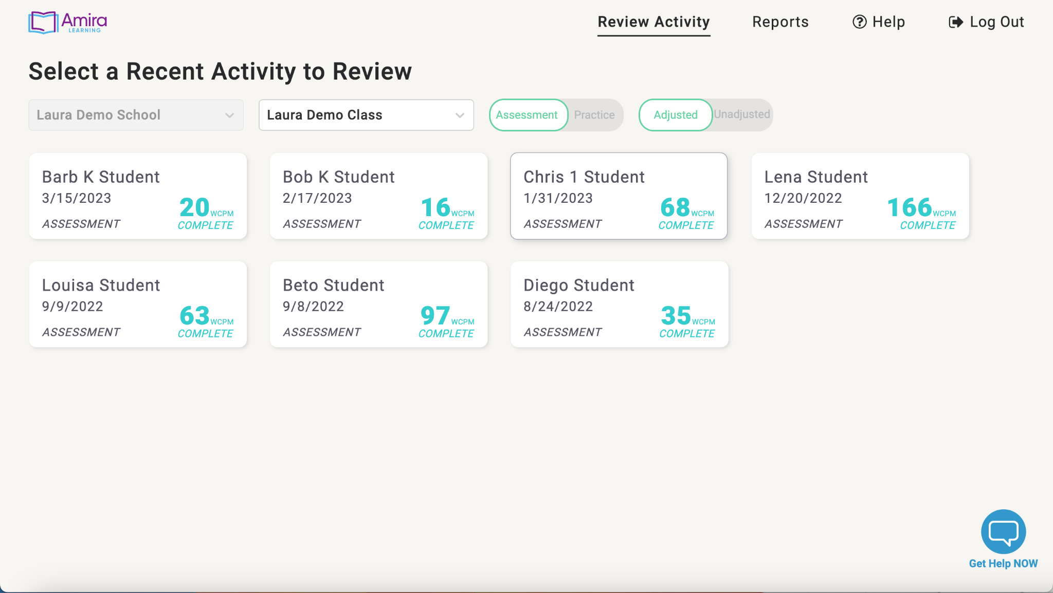
Notes:
To review one more time - since we want students reading on Amira every day - the best way to make sure that’s happening is in the Tracking Report!
From your Teacher Dashboard, hit Reports.

Slide 41
Notes:
Select the Tracking Report

Slide 42
Notes:
You’ll see time spent reading and number of stories for this week right in the middle. It’s color coded, so you’ll see stories and minutes turn yellow and then green by the end of the week if students are on pace to reach 30 minutes per week.
One other thing to note - my report doesn’t have any stories read yet, but once I do there will be an “Incomplete stories” column. This is a good place to look to see whether students are spending their time “story shopping”; choosing a story, reading a page or two, then going back to pick a new story. The tracking report is a great way to follow up with students and make sure that they’re having success reading with Amira.

Slide 43
Notes:
The other thing you can do from the tracking report is to configure practice for students. If you have students who are also developing their literacy in Spanish….

Slide 44
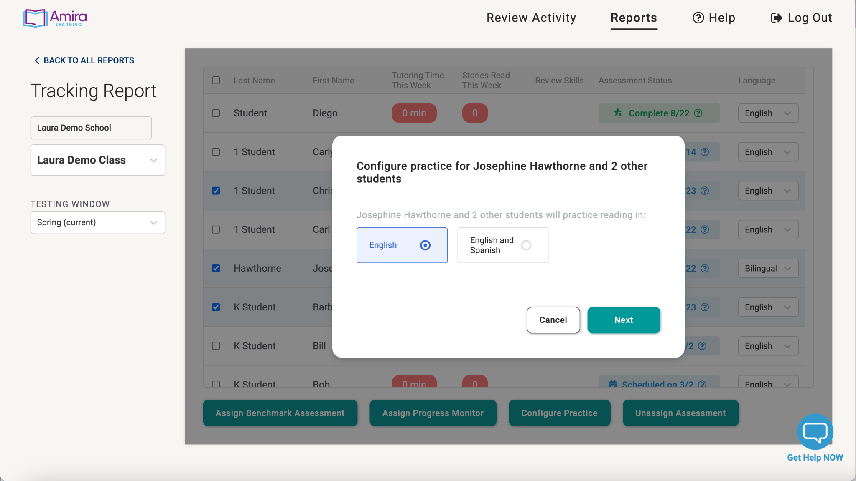
Notes:
Everything that Amira does in English, she does in Spanish, so you’re able to configure the practice so that students can practice reading in both language. We don’t have time to go over the process in full, but if you want to do this, the resources are linked in your handout.

Slide 45
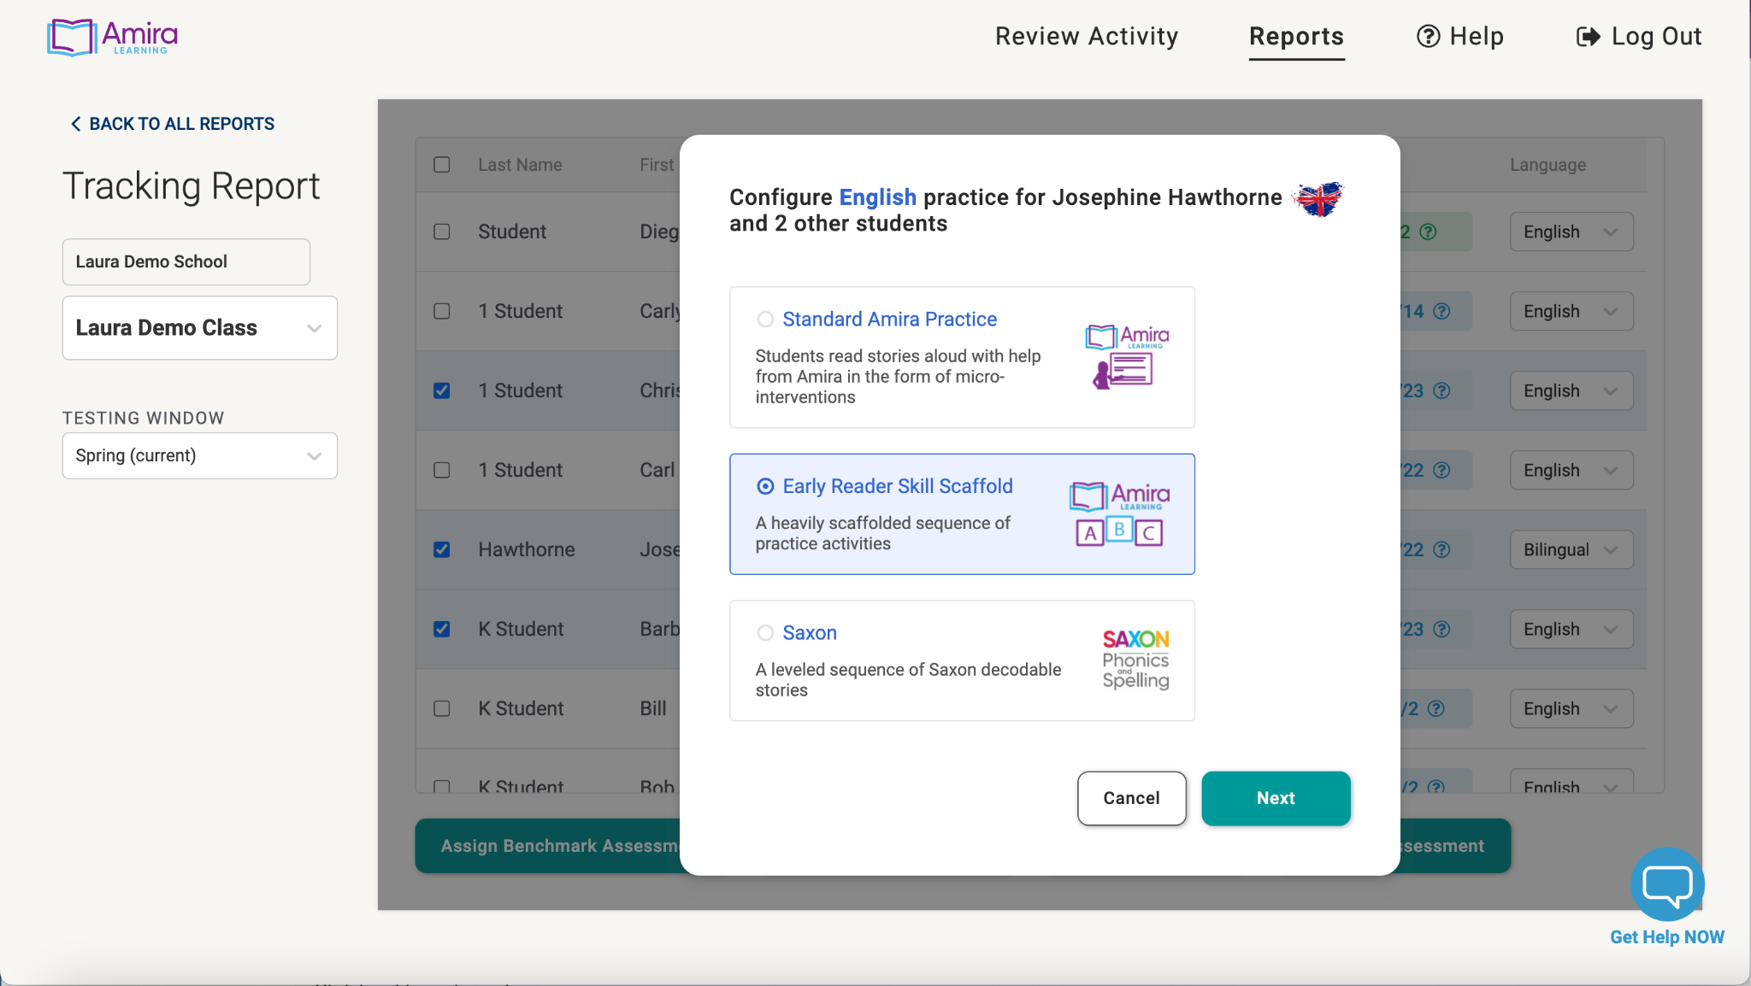
Notes:
The other configure practice option is for readers who are not yet reading connected text. For these students, you can hit configure practice and can add them to the Early Reader Skills scaffold. This will allow learners to practice the fundamentals of phonemic awareness and decoding and receive those same science of reading interventions from Amira. We recommend starting K-1 students in Early Reader. If you’re not sure if a student is an early reader, we’ll cover how to assign an assessment next which can help you determine who should be in the Early Reader Skills Scaffold.

Slide 46
Help Amira get to know your students
Getting to know your students helps me support them!
Listen to reading
Tracking Report
Setting up assessment
Notes:
Finally, we’ll cover how to set up the Benchmark Assessment so you can get insights into your students’ reading abilities. The Benchmark Assessment can be given 3 times per year, and provides valuable insights into students’ reading abilities. It also places students with the correct text level, so that when they choose stories they’re reading at their instructional level.
Now, I’m going to show you how to do this because I want it to be easy for you when you need it. But before we hop in, I want to remind you that reading to an AI tutor can be weird! Kids need an opportunity to get used to Amira. Remember that you’ll introduce Amira to your students and let them practice reading 3-6 times before having them take the assessment. This will help make sure their assessment data is more accurate.

Slide 47
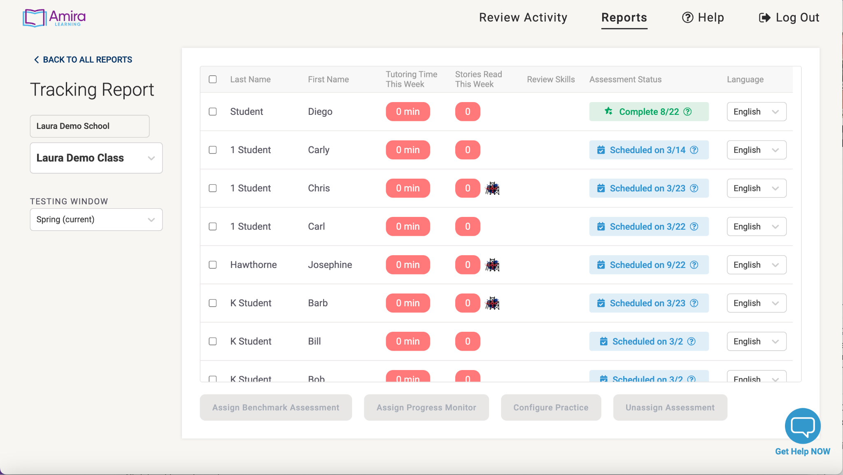
Notes:
Assigning the Benchmark Assessment happens in the Tracking Report. You’ll select the check box next to “last name”.

Slide 48
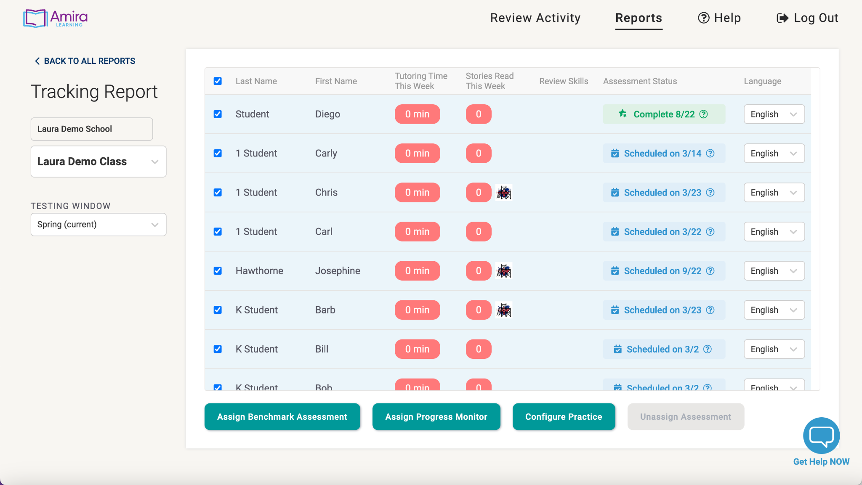
Notes:
This will select all your students.

Slide 49
Notes:
Next click “Assign Benchmark Assessment”

Slide 50
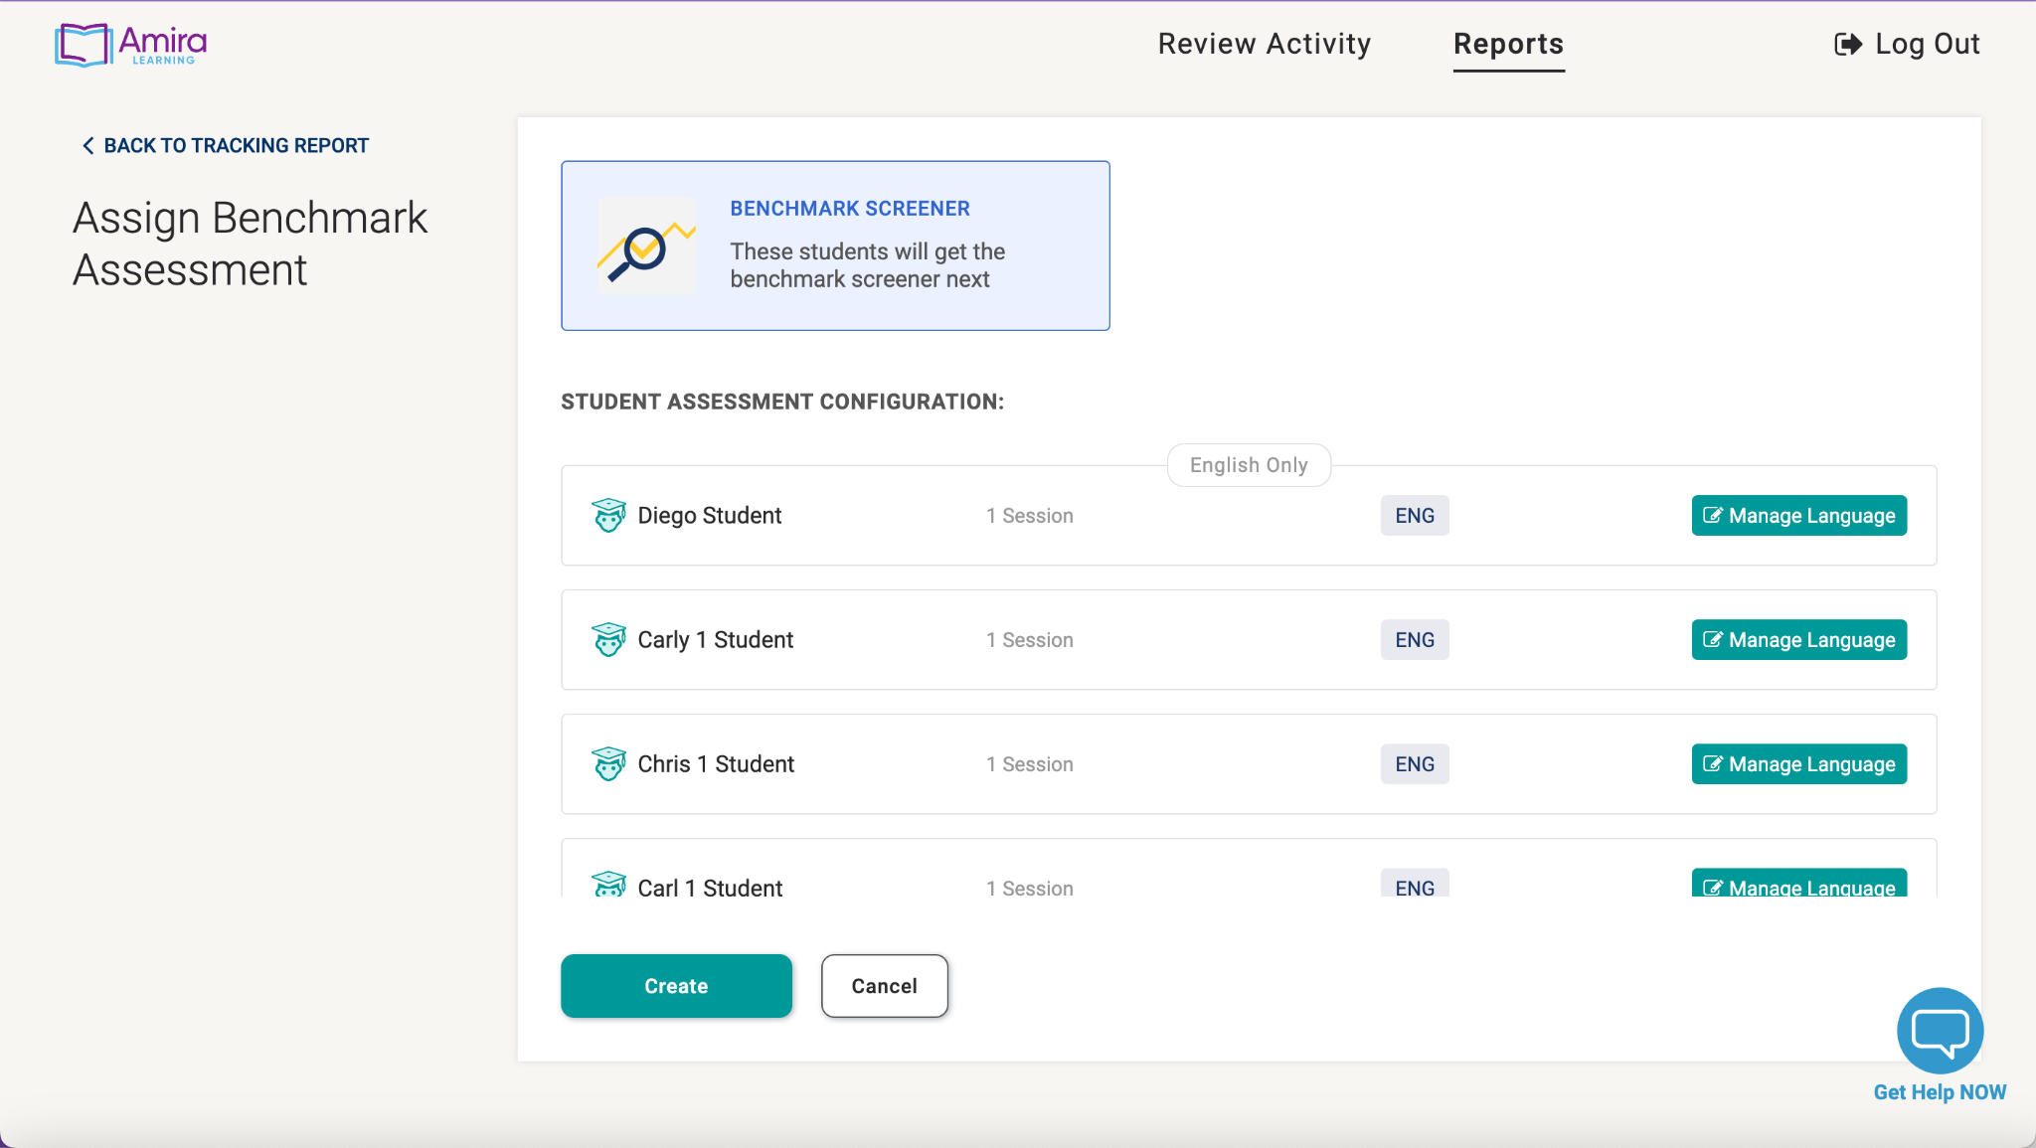
Notes:
You’ll then be able to confirm all the students who are taking the benchmark.

Slide 51
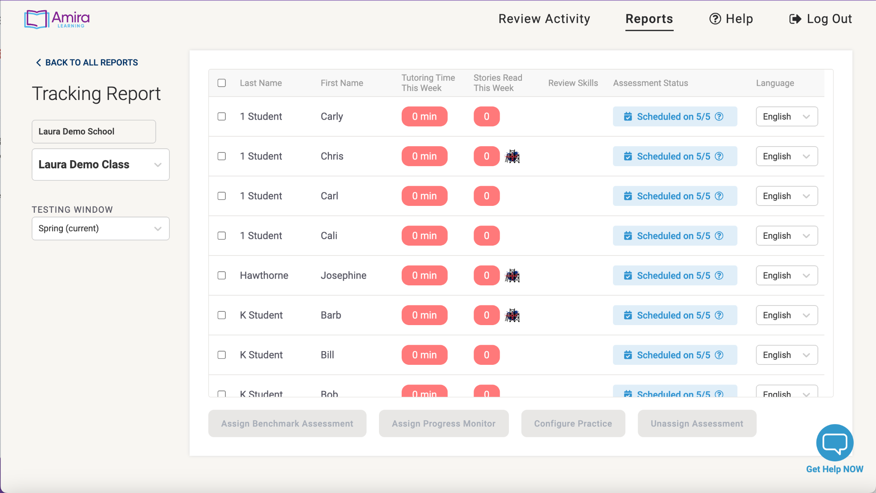
Notes:
You’ll now see that all students are scheduled for an assessment when they next log in.

Slide 52
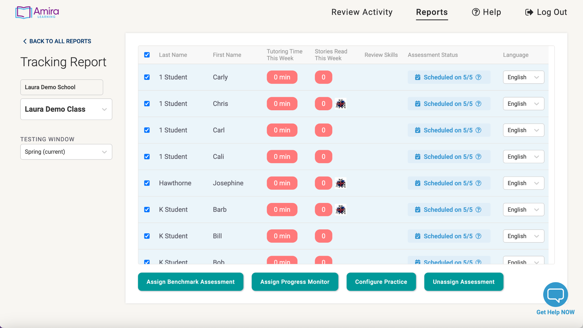
Notes:
Remember, we recommend that students practice reading with Amira for at least a week before you administer the assessment. This will allow them to get used to reading with Amira so that the assessment is more accurate. To unassign an assessment, select your students,

Slide 53
Notes:
Then hitting “unassign assessment”.

Slide 54
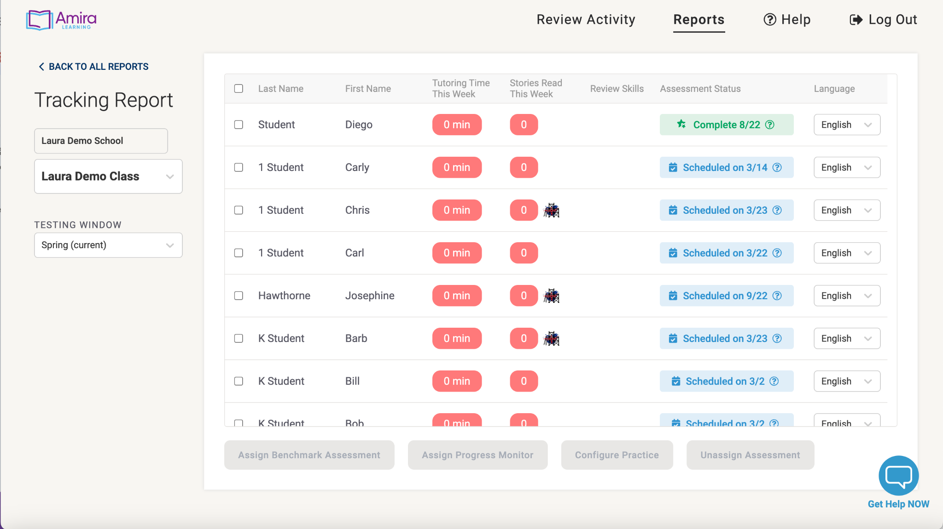
Notes:
You should then see the assessment status go back to “Unassessed”.

Slide 55
Teacher Work Time
9/14
Notes:
I want to ensure that you are able to assign the Benchmark. Take a moment now to go to the Tracking Report and practice assigning the Benchmark Assessment. After you do that, practice unassigning it so that students will be back in practice mode. You’ll also want to choose the date you will give the Benchmark Assessment, and add it to your calendar and your exit ticket! You are also welcome to finish out the exit ticket once you’ve taken those actions in the tracking report.
Let’s take a few minutes to do this.
You’ll also see that configuring practice for your early readers or for Spanish is optional- we didn’t have time to go over that in full today but you can use the “How to’s” link to see it step by step.
If you have any questions about how to get your students set up in Amira feel free to ask away!
go.amiralearning.com/meet-amira-resources

Slide 56
Notes:
We’ve spent some time going over all Amira has to offer and our resources to help you get started. You might be feeling a little overwhelmed or you might be excited and ready to start. We’ll close out the session with planning time, but before we do, we want to give you an opportunity to hear from a teacher who has already implemented Amira to hear what the journey was like for her. As you listen, think about what your goals with Amira are for this year!

Slide 57
Teacher Work
Time
Notes:
We’re just about at the end of our session together, and we have one more block of teacher work time before we close out. In the next 4 minutes, please finish your exit ticket, use this as flex time for any planning you still want to do, or ask any questions you still have! Go ahead and get started, and I’m ready to answer questions and help.
go.amiralearning.com/meet-amira-resources

Slide 58
“My Champion!”
Notes:
Thank you so much for your time and participation! When it asks who your trainer is, please put “My Champion!”. If you haven’t finished the exit ticket, please take a few minutes to do so.

Slide 59
We’re here to help!
Notes:
We know that we’ve shared a lot of information today and we don’t expect you to go forth and do this all on your own, we want to help!

Slide 60
chat
Notes:
Amira offers several avenues for support. They have a live chat available weekdays during business hours in the bottom right hand corner of your Teacher Dashboard.

Slide 61
support@amiralearning.com
@AmiraLearning
@Amira_Learning
Notes:
You can also email support@amiralearning.com to get help with an issue.
You’re also invited to follow Amira on Twitter and Instagram!

Slide 62
Next steps
Read 2 stories every day.
Explore your reports.
LaunchAmira!
Notes:
We’ve been over a lot together today. You got an opportunity to set up your students in Amira and plan for how you’ll introduce them to her. Hopefully you’re feeling ready to roll! If not, make sure you chat in or use our support email - we want to make sure you have everything you need.
Here’s what happens next. First you’ll get started having your students read with Amira. Students will read 2 stories with Amira every day. This is going to give you amazing insights into your readers so after you’ve been using Amira for a few weeks, make sure you take time to explore some of the reports and see the data! I didn’t want to overload you with information about all our reports in this session, and we know it will be way more interesting to you with YOUR students’ information, but please feel free to explore the reports on your own. We offer courses on Amira University, asynchronous training, and live training to talk through the data and reports and how to best use them to support your instruction.

Slide 63
“My Champion”
Notes:
Thank you so much for your time and participation! If you haven’t finished the exit ticket, please take a few minutes to do so.

Slide 64
Thank you!
AMIRA © 2022 | CONFIDENTIAL
Notes:
Thanks so much for joining us and we can’t wait to see your students grow with Amira!

